Slide 1
Employment trend data: where are the jobs?
Report to support: Australian Technology Network (ATN) Grants Scheme for Excellence in Learning and Teaching 2017
RMIT Careers & Employability: December 2017

Slide 2
Background
Australian Technology Network (ATN) Grants Scheme for Excellence in Learning and Teaching 2017
Project Leader: A/Prof Fiona Peterson, School of Media & Communication, RMIT University
Project Partners: RMIT University, Queensland University of Technology, University of Technology Sydney
Project Title: Digital work practices: where are the jobs, what are they, and how prepared are graduates?
Employment trend data will be analysed with RMIT Careers and Employability for sample areas of advertising, journalism, communication design, industrial design and engineering.
De-identified data will include Graduate Destination/Outcomes Survey and Australian Bureau of Statistics.
A labour insights tool 'Burning Glass' (licensed to RMIT) will also be used.
RMIT Careers and Employability has permission to use 'Burning Glass' data for the research.
The following questions will be explored to indicate where jobs are and what they are, including digital capabilities and digital work practices:
- Are graduates securing jobs locally or are they mobile, and what are their roles?
- Are there more graduates in Melbourne competing for the jobs available?
- Are roles changing more rapidly in Melbourne than Sydney and Brisbane (or vice versa)?

Slide 3
Data
1. RMIT graduate employment outcomes / demographics:
  Obtained via responses to the following national graduate surveys (typically polled biannually, 4 months after graduation):
    2015 - Australian Graduate Survey (AGS) & Graduate Outcome Survey (GOS)
    2016 - GOS
  ABS data used where required to describe ANZSIC (industry) / ANZSOC (occupation) codes from survey responses
Please note:
* The graduate survey instrument transitioned from the AGS to the GOS in mid 2015. Graduate surveys will now be facilitated via the GOS.
A result of this transition there were a number of methodology changes which impacted the comparability of graduate data.
Assumptions have been made in this preparation of this presentation.
** To isolate employment outcomes / demographics by national field of education (NFOE) (engineering etc), classifications were made based on RMIT program name, RMIT program descriptions and / or major area of study where applicable.
As such, breakdowns provided by area will be indicative in nature and not a perfect subsection of the student population.
2. RMIT actual graduate numbers:
  SSG Business Systems Support Team (Student Administration Management System (SAMS))
3. Labour market indicators / comparisons:
  Labour Insights™ tool from Burning Glass
Please note:
*** Labour Insights™ is not a perfect classifier of job ads and so the breakdowns herein should be taken as an indicative analysis only.
To isolate journalism and advertising jobs, as the market is comparatively smaller, searches were run using combinations of key skills that an advertising or journalism degree would reasonably provide (e.g. show listings that ask for skills in journalism, digital journalism, print media etc.).

Slide 4
Contents
The three main research questions were explored in the following manner:
1. “Are graduates securing jobs locally or are they mobile, and what are their roles?”
  1.1. RMIT graduates vs. RMIT survey respondents
  1.2. Are RMIT graduates working? And where?
  1.3. What roles are RMIT graduates working in?
2. “Are there more graduates in Melbourne competing for the jobs available?”
  2.1. Supply vs. demand
3. “Are roles changing more rapidly in Melbourne than Sydney and Brisbane (or vice versa)?”
  3.1. ‘Top ten job titles’ 2015 vs. 2016
  3.2. ‘Top ten software skills’ 2015 vs. 2016 – for NFOE only
4. Appendices
  4.1. ‘Biggest movers’ 2015 vs. 2016 (job titles)
  4.2. ‘Biggest movers’ 2015 vs. 2016 (software skills) – for NFOE only

Slide 5
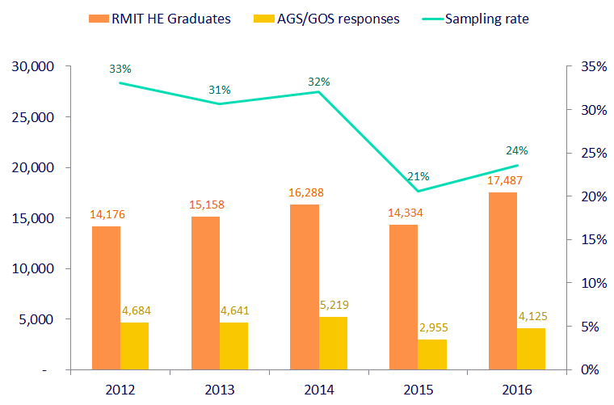
1.1. RMIT graduates vs. RMIT survey respondents
Overall RMIT
Updated
Number of RMIT graduates growing over time, however responses appear to be falling
New survey instrument (GOS) implemented in 2015
Note: survey responses may not be representative of actual graduate population

Slide 6
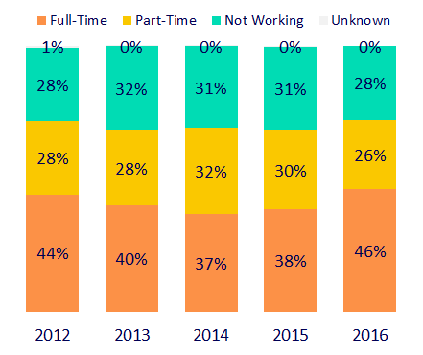
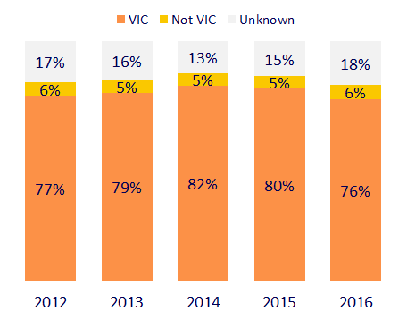
1.2. Are RMIT graduates working? And where?
Overall RMIT
Graduate employment outcomes
Graduates in work (full-time & part-time) by state
Of those that provided a location, around 5%-6% were not working in VIC across the period
Proportion of full-time employment grew in 2016, lowest % ‘not working’ since 2012
New survey instrument (GOS) implemented in 2015 – different question phrasing and definition

Slide 7
1.3. What roles are RMIT graduates working in?
Overall RMIT
Top 25 most common jobs (from graduate survey responses)
2012 |  | 2014 |  | 2016
Occupation | Count | Occupation | Count | Occupation | Count
primary teacher | 50 | secondary teacher | 44 | Sales Assistant (General) | 264
secondary teacher | 47 | primary teacher | 43 | Marketing Specialist | 56
accountant | 35 | lecturer | 25 | Accountant (General) | 53
registered nurse | 26 | registered nurse | 21 | Waiter | 53
lecturer | 24 | accountant | 20 | Architect | 52
osteopath | 18 | consultant | 19 | Program or Project Administrator | 50
general nurse | 17 | project manager | 19 | General Clerk | 43
engineer | 16 | graduate engineer | 18 | Public Relations Professional | 39
chiropractor | 14 | graduate architect | 15 | Sales and Marketing Manager | 38
graphic designer | 14 | osteopath | 14 | Social worker | 37
project manager | 14 | software engineer | 13 | Developer Programmer | 37
graduate engineer | 13 | primary school teacher | 11 | University Lecturer | 35
business analyst | 12 | project engineer | 11 | Graphic Designer | 31
graduate | 12 | teacher | 11 | Early Childhood (Pre-primary School) Teacher | 30
consultant | 11 | analyst | 10 | Primary School Teacher | 30
graduate nurse | 11 | engineer | 10 | University Tutor | 29
intern radiographer | 11 | director | 9 | CIVIL ENGINEER | 29
project coordinator | 11 | graduate | 9 | mechanical engineer | 27
project engineer | 11 | graphic designer | 9 | SOFTWARE ENGINEER | 26
town planner | 11 | kindergarten teacher | 9 | Urban and Regional Planner | 26
contract administrator | 10 | assistant valuer | 8 | Careers counsellor | 25
kindergarten teacher | 10 | chiropractor | 8 | Registered Nurses nfd | 24
radiographer | 10 | intern radiation therapist | 8 | Retail Supervisor | 24
account executive | 9 | structural engineer | 8 | CHIROPRACTOR | 24
analyst | 9 | business analyst | 7 | MedIcal laboratory scientist | 23
Please also note that these results reflect point-in-time data and are subject to change as improvements are made to the aggregation and reporting methodologies. Burning Glass does not recommend use of this data for time series reporting.

Slide 8
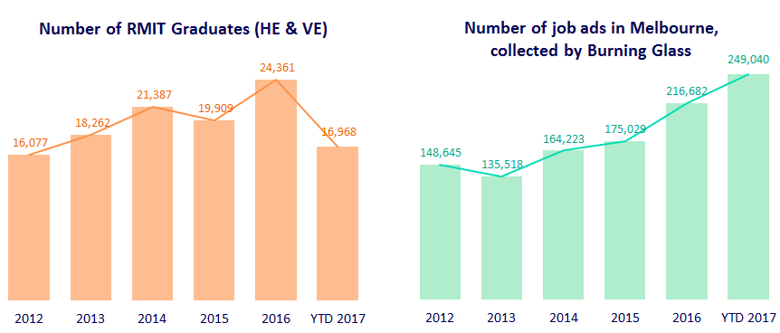
2.1. Supply vs. demand
Overall RMIT
Updated
Please also note that these results reflect point-in-time data and are subject to change as improvements are made to the aggregation and reporting methodologies. Burning Glass does not recommend use of this data for time series reporting.
Broad trend appears MORE RMIT graduates competing for MORE jobs in Melbourne
More RMIT students graduating (predominately stay in VIC)
Burning glass total ads for Melbourne (all jobs) shows recent trend upwards

Slide 9
  3.1. ‘Top ten job titles’ 2016 vs. 2017
  Burning Glass: All jobs
Updated
Melbourne
Sydney
Brisbane
Top 10 - 2016
Title | Count
Sales Representative | 7,101
Project Manager | 5,415
Office / Administrative Assistant | 5,298
Software Developer / Engineer | 5,019
Customer Service Representative | 4,448
Store Manager | 3,464
Accountant | 3,249
Account Manager | 3,022
Registered Nurse | 2,392
Solicitor | 2,312
Top 10 - 2016
Title | Count
Sales Representatives | 15,625
Project Coordinator | 4,837
Retail Manager | 3,611
Receptionist | 3,172
Finance Manager | 3,080
Client Services Clerk | 3,043
Financial Analyst | 2,959
Qualified Accountant | 2,752
Systems Analyst | 2,612
Ict Project Manager | 2,569
Top 10 - 2016
Title | Count
Sales Representatives | 3,389
Retail Manager | 1,589
Qualified Accountant | 1,352
Administration Officer | 1,020
Project Coordinator | 1,018
Receptionist | 896
Retail Sales | 834
Sales Assistant | 820
Enrolled Nurse | 808
Systems Analyst | 807
Top 10 – 2017 YTD
Title | Count
Sales Representative | 8,449
Project Manager | 6,270
Office / Administrative Assistant | 5,947
Software Developer / Engineer | 5,600
Customer Service Representative | 5,190
Store Manager | 3,420
Solicitor | 3,346
Accountant | 3,280
Account Manager | 3,069
Registered Nurse | 2,980
Top 10 – 2017 YTD
Title | Count
Sales Representatives | 17,503
Project Coordinator | 6,070
Retail Manager | 4,622
Receptionist | 3,929
Qualified Accountant | 3,898
Developer Programmer | 3,623
Client Services Clerk | 3,613
Construction Foreman/Manager | 3,314
Financial Analyst | 3,236
Systems Analyst | 3,216
Top 10 – 2017 YTD
Title | Count
Sales Representatives | 3,134
Retail Manager | 1,389
Project Coordinator | 1,222
Qualified Accountant | 1,136
Registered Nurse | 1,051
Administration Officer | 992
Construction Foreman/Manager | 916
Enrolled Nurse | 911
Property Manager | 872
Systems Analyst | 771
Please also note that these results reflect point-in-time data and are subject to change as improvements are made to the aggregation and reporting methodologies. Burning Glass does not recommend use of this data for time series reporting.

Slide 10
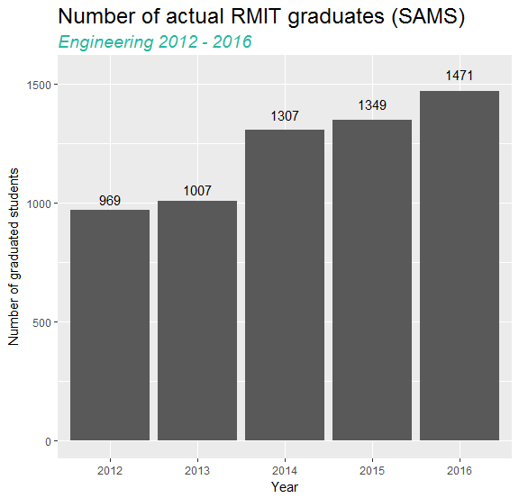
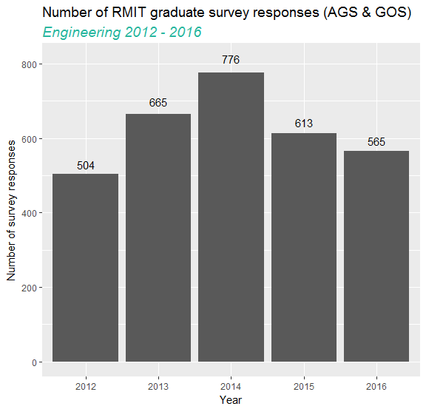
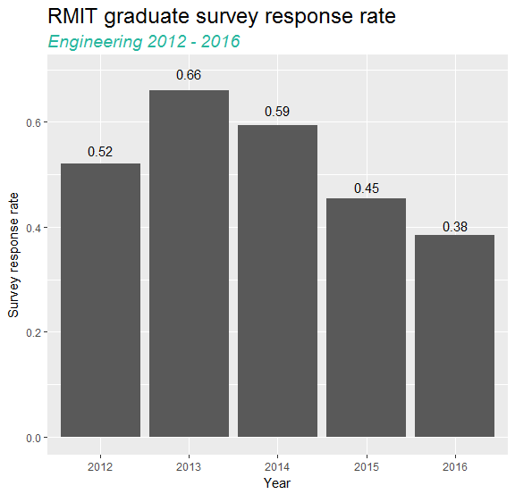
1.1. RMIT graduates vs. RMIT survey respondents
Engineering
Number of RMIT engineering graduates growing over time, however response rates appear to be falling
New survey instrument (GOS) implemented in 2015
Note: survey responses may not be representative of actual graduate population

Slide 11
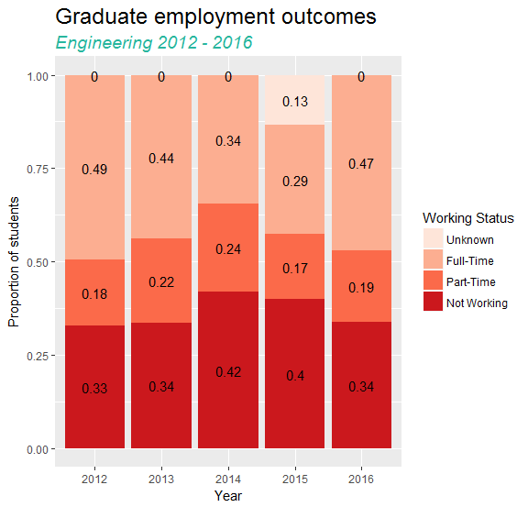
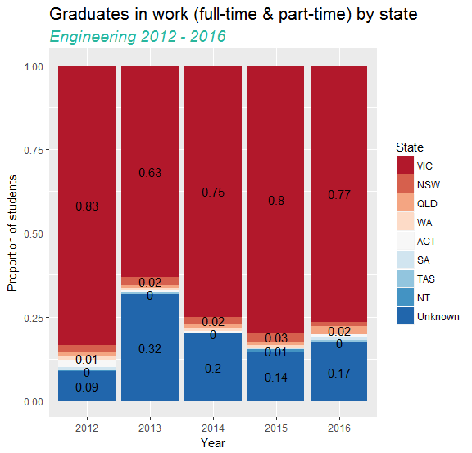
1.2. Are RMIT graduates working? And where?
Engineering
Of those that provided a location, 1.05% (on average) not in VIC across the period
Proportion of full-time employment grew in 2016, still over 1/3 ‘not working’
New survey instrument (GOS) implemented in 2015 – high levels of unknown, missing data

Slide 12
1.3. What roles are RMIT graduates working in?
Engineering
Top 10 most common jobs (from graduate survey responses)
2012 |  | 2014 |  | 2016
Occupation | Count | Occupation | Count | Occupation | Count
engineer | 13 | graduate engineer | 18 | civil engineer | 24
graduate engineer | 11 | engineer | 8 | mechanical engineer | 23
project engineer | 11 | structural engineer | 8 | engineering professionals | 19
electrical engineer | 9 | project engineer | 7 | electrical engineer | 18
civil engineer | 8 | design engineer | 6 | engineering manager | 14
mechanical engineer | 7 | graduate civil engineer | 5 | structural engineer | 12
structural engineer | 5 | site engineer | 5 | electronics engineer | 10
environmental engineer | 4 | process engineer | 4 | sales assistant (general) | 10
process engineer | 4 | environmental engineer | 3 | aeronautical engineer | 8
graduate electrical engineer | 3 | graduate structural engineer | 3 | university lecturer | 7

Slide 13
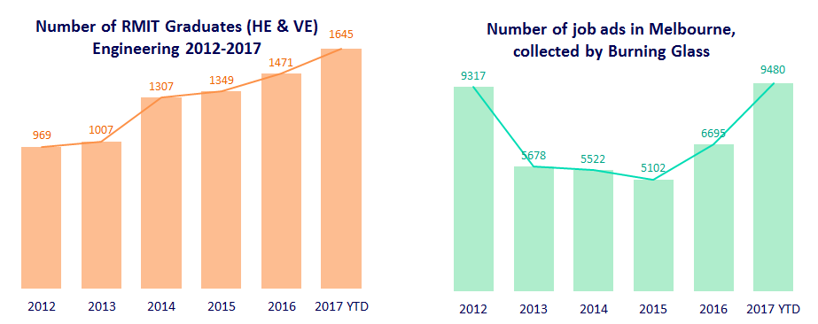
2.1. Supply vs. demand
Engineering
Updated
Please also note that these results reflect point-in-time data and are subject to change as improvements are made to the aggregation and reporting methodologies. Burning Glass does not recommend use of this data for time series reporting.
Broad trend appears MORE RMIT engineering graduates competing for LESS engineering jobs
More RMIT engineering students graduating (predominately stay in VIC)
Burning glass total ads for Melbourne (engineering job search) highlights a smaller market in recent years and gradually recovers

Slide 14
  3.1. ‘Top ten job titles’ 2016 vs. 2017
  Burning Glass: Engineering search
Updated
Melbourne
Sydney
Brisbane
Top 10 - 2016
Title | Count
Civil Engineer | 606
Electrical Engineer | 322
Mechanical Engineer | 298
Engineering Manager/ Project Engineer | 263
Revit Architectural Drafter | 258
Surveyor | 221
Structural Design | 207
Engineering Manager | 166
Electrical Engineering Technician | 139
Civil Draftsperson | 135
Top 10 - 2016
Title | Count
Civil Engineer | 2,183
Electrical Engineer | 840
Engineering Manager/ Project Engineer | 824
Structural Design | 776
Mechanical Engineer | 640
Surveyor | 401
Structural Drafter | 400
Civil Draftsperson | 391
Civil Engineering Draftsperson | 375
Revit Architectural Drafter | 302
Top 10 - 2016
Title | Count
Civil Engineer | 417
Structural Design | 303
Electrical Engineer | 237
Civil Engineering Draftsperson | 203
Mechanical Engineer | 190
Engineering Manager/ Project Engineer | 177
Structural Engineer | 77
Civil Draftsperson | 76
Engineering Manager | 76
Surveyor | 55
Top 10 - 2015
Title | Count
Civil Engineer | 1,003
Structural Design | 506
Engineering Manager/ Project Engineer | 477
Electrical Engineer | 457
Mechanical Engineer | 339
Surveyor | 284
Structural Drafter | 225
Civil Engineering Draftsperson | 210
Civil Draftsperson | 209
Revit Architectural Drafter | 189
Top 10 - 2015
Title | Count
Civil Engineer | 333
Mechanical Engineer | 212
Structural Design | 185
Electrical Engineer | 179
Civil Engineering Draftsperson | 123
Engineering Manager/ Project Engineer | 120
Revit Architectural Drafter | 73
Structural Engineer | 64
Structural Drafter | 59
Civil Draftsperson | 56
Top 10 - 2016
Title | Count
Sales Representatives | 17,503
Project Coordinator | 6,070
Retail Manager | 4,622
Receptionist | 3,929
Qualified Accountant | 3,898
Developer Programmer | 3,623
Client Services Clerk | 3,613
Construction Foreman/Manager | 3,314
Financial Analyst | 3,236
Systems Analyst | 3,216
Top 10 - 2016
Title | Count
Sales Representatives | 3,134
Retail Manager | 1,389
Project Coordinator | 1,222
Qualified Accountant | 1,136
Registered Nurse | 1,051
Administration Officer | 992
Construction Foreman/Manager | 916
Enrolled Nurse | 911
Property Manager | 872
Systems Analyst | 771
Top 10 – 2017 YTD
Title | Count
Civil Engineer | 1,833
Computer Systems Engineer / Architect | 1,192
Software Developer / Engineer | 1,129
Mechanical Engineer | 644
Electrical Engineer | 570
Engineering Manager | 507
Network Engineer / Architect | 284
Transport Engineer | 208
Project Manager | 162
Other Technical Sales Representative | 158
Top 10 – 2017 YTD
Title | Count
Civil Engineer | 3,600
Software Developer / Engineer | 2,324
Computer Systems Engineer / Architect | 2,111
Electrical Engineer | 944
Mechanical Engineer | 909
Engineering Manager | 863
Network Engineer / Architect | 417
Network Support Officer | 353
Cyber / Information Security Engineer / Analyst | 289
Data Architect | 250
Top 10 – 2017 YTD
Title | Count
Civil Engineer | 452
Software Developer / Engineer | 220
Computer Systems Engineer / Architect | 201
Electrical Engineer | 118
Mechanical Engineer | 112
Engineering Manager | 98
Network Engineer / Architect | 43
Process Engineer | 37
Project Manager | 36
Mining Engineer | 31
Please also note that these results reflect point-in-time data and are subject to change as improvements are made to the aggregation and reporting methodologies. Burning Glass does not recommend use of this data for time series reporting.

Slide 15
  3.2. ‘Top ten software skills’ 2016 vs. 2017
  Burning Glass: Engineering search
Updated
Melbourne
Sydney
Brisbane
Top 10 - 2016
Skill | Count
Computer Aided Draughting/Design (CAD) | 629
Revit | 606
Microstation | 209
Microsoft Office | 181
Microsoft Excel | 152
Selenium | 89
Microsoft Windows | 79
JAVA | 76
SQL | 74
Design Software | 68
Top 10 - 2016
Skill | Count
Revit | 1,093
Computer Aided Draughting/Design (CAD) | 974
Civil 3D | 331
Microsoft Excel | 330
Microsoft Office | 308
LINUX | 177
JAVA | 172
Python | 159
Microsoft Windows | 146
Selenium | 128
Top 10 - 2016
Skill | Count
Computer Aided Draughting/Design (CAD) | 333
Revit | 226
Microsoft Office | 134
Microsoft Excel | 94
Design Software | 87
Microstation | 50
Civil 3D | 40
SAP | 34
JAVA | 30
Geographic Information System (GIS) | 27
Top 10 – 2017 YTD
Skill | Count
Microsoft Windows | 951
LINUX | 806
JAVA | 674
Python | 638
SQL | 519
JavaScript | 438
Git | 410
Microsoft Office | 347
Computer Aided Draughting/Design (CAD) | 327
Microsoft C# | 314
Top 10 – 2017 YTD
Skill | Count
Microsoft Windows | 1,853
LINUX | 1,842
Python | 1,412
JAVA | 1,392
SQL | 1,178
JavaScript | 1,044
C++ | 625
UNIX | 621
Git | 611
Microsoft C# | 568
Top 10 – 2017 YTD
Skill | Count
Microsoft Windows | 136
Microsoft Office | 121
LINUX | 112
JAVA | 86
Python | 84
C++ | 80
SQL | 70
Microsoft Excel | 67
JavaScript | 56
Computer Aided Draughting/Design (CAD) | 55
Please also note that these results reflect point-in-time data and are subject to change as improvements are made to the aggregation and reporting methodologies. Burning Glass does not recommend use of this data for time series reporting.

Slide 16
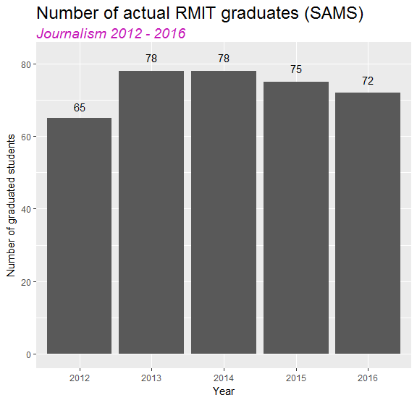
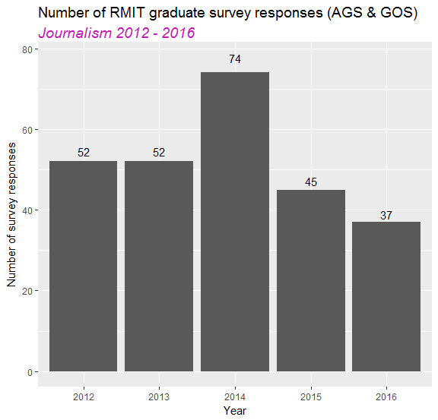
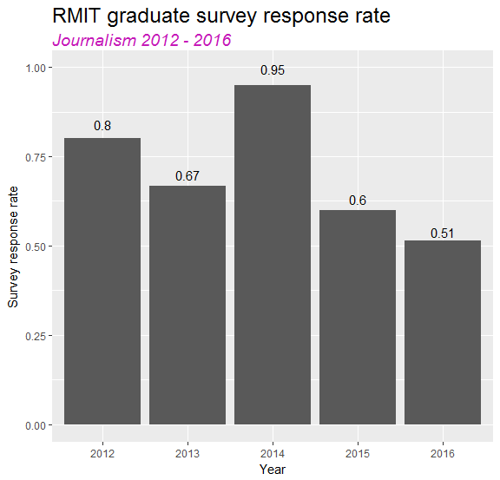
1.1. RMIT graduates vs. RMIT survey respondents
Journalism
Number of RMIT journalism graduates consistent since 2013, small samples causing exaggerated trends
New survey instrument (GOS) implemented in 2015
Note: survey responses may not be representative of actual graduate population

Slide 17
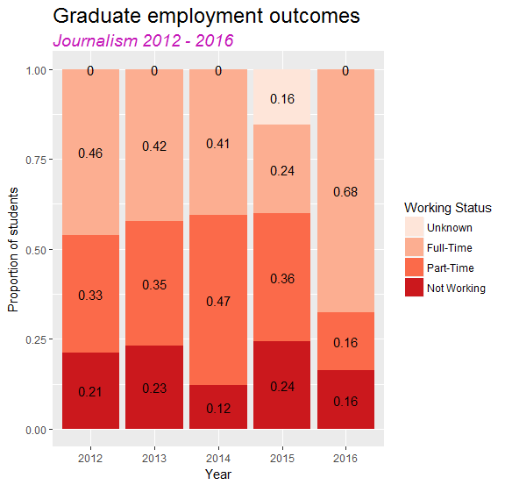
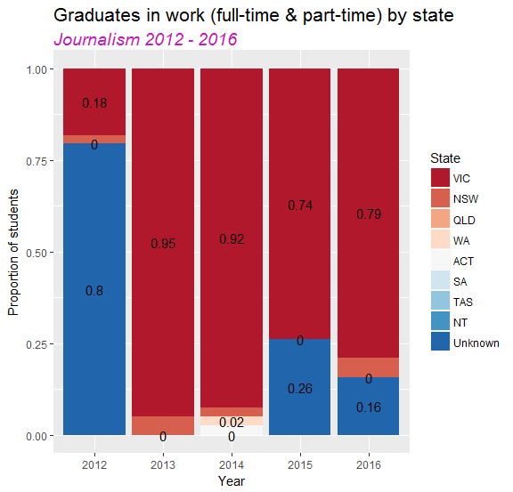
1.2. Are RMIT graduates working? And where?
Journalism
Of those that provided a location, 0.85% (on average) not in VIC across the period
Proportion of full-time employment grew dramatically in 2016 – skewed by small sample size
New survey instrument (GOS) implemented in 2015 – high levels of unknown, missing data

Slide 18
1.3. What roles are RMIT graduates working in?
Journalism
Top 10 most common jobs (from graduate survey responses)
2012 |  | 2014 |  | 2016
Occupation | Count | Occupation | Count | Occupation | Count
communications coordinator | 2 | journalist | 7 | print journalist | 13
editorial assistant | 2 | account coordinator | 2 | journalists and other writers | 2
communication coordinator | 1 | editor | 2 | public relations professional | 2
communications officer | 1 | brand, marketing & pr manager | 1 | automobile drivers | 1
customer care analyst | 1 | advertising coordinator | 1 | barista | 1
customer relations analyst | 1 | assistant editor | 1 | copywriter | 1
editor | 1 | assistant store manager | 1 | information officer | 1
helicopter administrator | 1 | communication and advocacy officer | 1 | media producer (excluding video) | 1
journalist | 1 | communications assistant | 1 | radio journalist | 1
journalist/reporter | 1 | contact centre officer | 1 | sales assistant (general) | 1

Slide 19
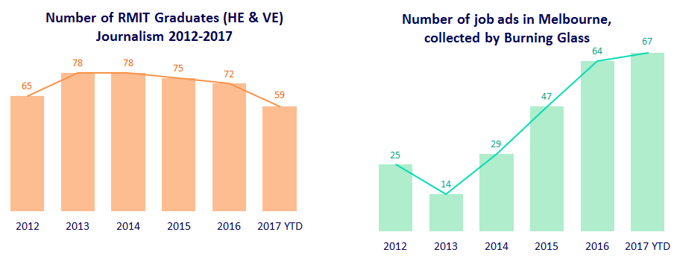
2.1. Supply vs. demand
Journalism
Updated
Please also note that these results reflect point-in-time data and are subject to change as improvements are made to the aggregation and reporting methodologies. Burning Glass does not recommend use of this data for time series reporting.
Broad trend appears SAME number of journalism RMIT graduates competing for MORE journalism jobs
Similar RMIT journalism students graduating (predominately stay in VIC)
Burning glass total ads for Melbourne (journalism job search) indicates increase in 2016

Slide 20
  3.1. ‘Top ten job titles’ 2016 vs. 2017
  Burning Glass: Journalism search
Updated
Melbourne
Sydney
Brisbane
Top 10 - 2016
Title | Count
Communications Officer | 106
Public Relations Professional | 39
Journalist | 38
Sales Representatives | 35
Copywriter | 27
Campaign Or Communications Manager | 23
Marketing Specialist | 22
Content Producer | 19
Personal Assistant | 18
Intern | 17
Top 10 - 2016
Title | Count
Journalist | 140
Communications Officer | 124
Campaign Or Communications Manager | 78
Marketing Specialist | 67
Sales Representatives | 65
Graphic Designer | 39
Copywriter | 35
Marketing Manager | 33
Content Producer | 32
Public Relations Professional | 32
Top 10 - 2016
Title | Count
Communications Officer | 59
Public Relations Professional | 22
Journalist | 16
Marketing Specialist | 14
Graphic Designer | 10
Receptionist | 9
Copywriter | 8
Marketing Manager | 8
Sales Representatives | 8
Marketing Content Creator | 7
Top 10 – 2017 YTD
Title | Count
Communications Coordinator | 119
Public Relations Specialist | 102
Public Relations Manager | 54
Copywriter | 26
Journalist | 25
Marketing Research Analyst | 25
Producer | 25
Writer | 24
Editor | 23
Marketing Specialist | 22
Top 10 – 2017 YTD
Title | Count
Communications Coordinator | 176
Public Relations Specialist | 125
Public Relations Manager | 88
Account Manager | 82
Journalist | 73
Producer | 56
Editor | 51
Marketing Research Analyst | 43
Marketing Manager | 40
Web Developer | 35
Top 10 – 2017 YTD
Title | Count
Communications Coordinator | 22
Public Relations Manager | 13
Journalist | 7
Marketing Specialist | 6
Document Controller | 5
Public Relations Specialist | 4
Web Developer | 3
Editor | 2
Marketing Manager | 2
Marketing Research Analyst | 2
Please also note that these results reflect point-in-time data and are subject to change as improvements are made to the aggregation and reporting methodologies. Burning Glass does not recommend use of this data for time series reporting.

Slide 21
  3.2. ‘Top ten software skills’ 2016 vs. 2017
  Burning Glass: Journalism search
Updated
Melbourne
Sydney
Brisbane
Top 10 - 2016
Skill | Count
Microsoft Office | 70
Facebook | 52
Social Media Platforms | 49
Microsoft Excel | 42
Adobe Photoshop | 34
Adobe Acrobat | 33
Platform as a Service (PaaS) | 29
Software as a Service (SaaS) | 29
Adobe Indesign | 25
Microsoft Powerpoint | 22
Top 10 - 2016
Skill | Count
Adobe Photoshop | 137
Facebook | 128
Microsoft Office | 121
Social Media Platforms | 108
Microsoft Excel | 75
Microsoft Powerpoint | 70
Adobe Indesign | 64
LinkedIn | 56
Adobe Acrobat | 55
Google Analytics | 39
Top 10 - 2016
Skill | Count
Microsoft Office | 36
Social Media Platforms | 35
Facebook | 31
Adobe Acrobat | 25
Google Analytics | 24
Adobe Photoshop | 21
Adobe Indesign | 20
LinkedIn | 17
Microsoft Sharepoint | 17
Google AdWords | 11
Top 10 – 2017 YTD
Skill | Count
Microsoft Office | 69
Facebook | 58
Social Media Platforms | 47
Microsoft Powerpoint | 33
Adobe Photoshop | 31
Google Analytics | 24
Microsoft Excel | 22
Adobe Acrobat | 18
Microsoft Word | 18
LinkedIn | 16
Top 10 – 2017 YTD
Skill | Count
Social Media Platforms | 84
Microsoft Office | 83
Facebook | 74
Microsoft Excel | 66
Adobe Photoshop | 63
Adobe Acrobat | 40
Microsoft Powerpoint | 37
Adobe Indesign | 31
Google Analytics | 26
LinkedIn | 24
Top 10 – 2017 YTD
Skill | Count
Microsoft Office | 13
Microsoft Excel | 11
Microsoft Powerpoint | 9
Microsoft Sharepoint | 6
Microsoft Windows | 6
Social Media Platforms | 5
Web Analytics | 5
Google AdWords | 4
Customer Relationship Management (CRM) | 2
Facebook | 2
Please also note that these results reflect point-in-time data and are subject to change as improvements are made to the aggregation and reporting methodologies. Burning Glass does not recommend use of this data for time series reporting.

Slide 22
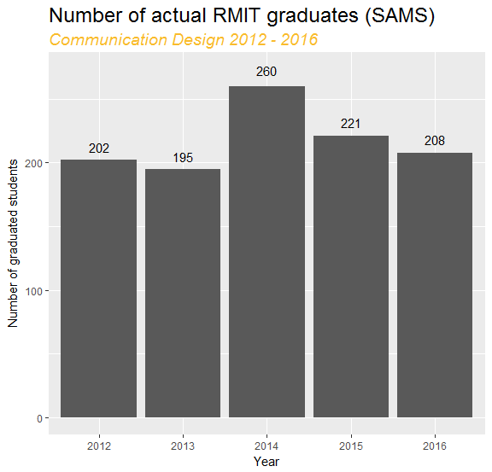
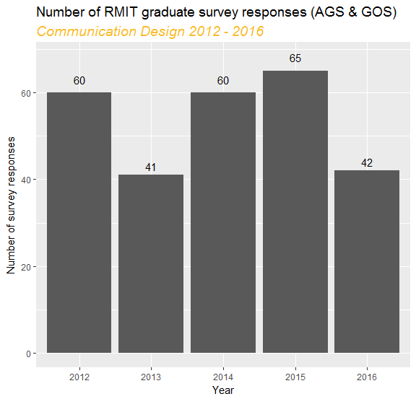
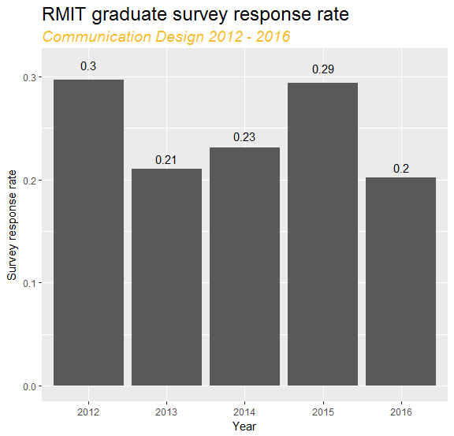
1.1. RMIT graduates vs. RMIT survey respondents
Communication Design
Number of RMIT comm design graduates down 20% since 2014, response rate fluctuating across the period
New survey instrument (GOS) implemented in 2015
Note: survey responses may not be representative of actual graduate population

Slide 23
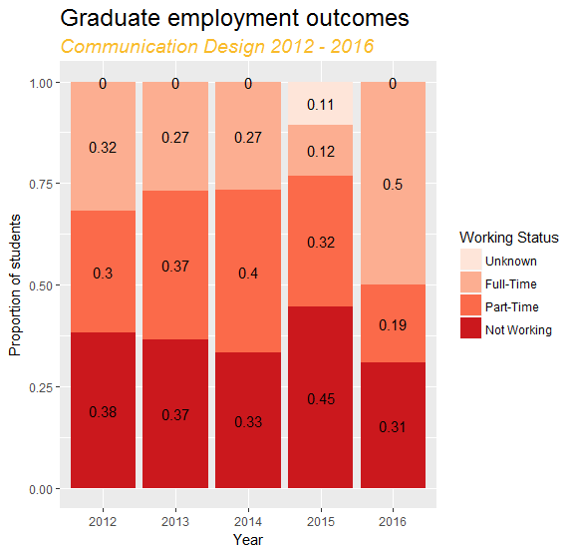
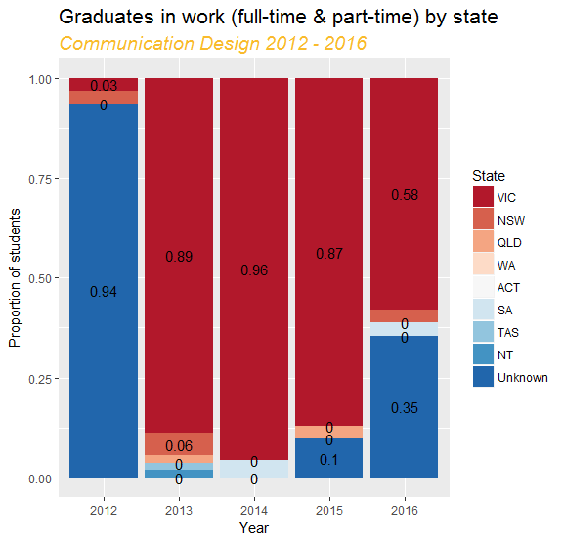
1.2. Are RMIT graduates working? And where?
Communication Design
Of those that provided a location, 2.26% (on average) not in VIC across the period
Proportion of full-time employment grew dramatically in 2016 – skewed by small sample size
New survey instrument (GOS) implemented in 2015 – high levels of unknown, missing data

Slide 24
1.3. What roles are RMIT graduates working in?
Communication Design
Top 10 most common jobs (from graduate survey responses)
2012 |  | 2014 |  | 2016
Occupation | Count | Occupation | Count | Occupation | Count
graphic designer | 6 | graphic designer | 3 | graphic designer | 10
designer | 2 | junior graphic designer | 2 | advertising specialist | 1
casi snowboard instructor | 1 | administrator and receptionist | 1 | bar attendant | 1
communication designer | 1 | assistant store manager | 1 | cash van salesperson | 1
design consultant | 1 | communication designer | 1 | conference and event organiser | 1
finished artist | 1 | creative designer/analyst | 1 | graphic and web designers, and illustrators | 1
graphic designer / illustrator | 1 | designer / web developer | 1 | receptionist (general) | 1
graphic designer / production manager | 1 | digital creative | 1 | sales and marketing manager | 1
kindergarten teacher | 1 | head of design & digital communications | 1 | sales assistant (general) | 1
owner/director/designer | 1 | managing director | 1 | specialist managers | 1

Slide 25
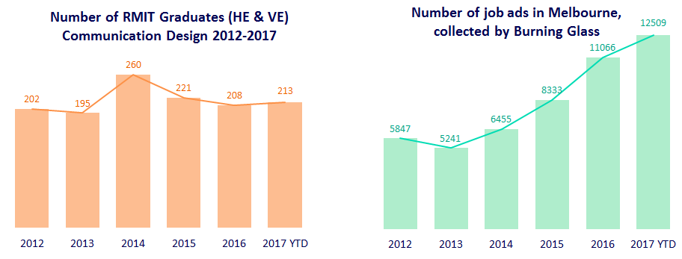
2.1. Supply vs. demand
Communication Design
Updated
Please also note that these results reflect point-in-time data and are subject to change as improvements are made to the aggregation and reporting methodologies. Burning Glass does not recommend use of this data for time series reporting.
Broad trend appears LESS RMIT com design graduates competing for MORE number of com design jobs
Less RMIT com design students graduating (predominately stay in VIC)
Burning glass total ads for Melbourne (com design job search) shows reasonably increasing market since 2014

Slide 26
  3.1. ‘Top ten job titles’ 2016 vs. 2017
  Burning Glass: Communication Design search
Updated
Melbourne
Sydney
Brisbane
Top 10 – 2016
Title | Count
Marketing Specialist | 631
Sales Representatives | 617
Marketing Manager | 453
Communications Officer | 375
Graphic Designer | 316
Campaign Or Communications Manager | 214
User Experience Designer | 177
Interior Designer | 158
Project Coordinator | 135
Public Relations Professional | 133
Top 10 – 2016
Title | Count
Sales Representatives | 1,619
Marketing Specialist | 1,225
Marketing Manager | 1,087
Graphic Designer | 766
Campaign Or Communications Manager | 523
Communications Officer | 424
Ict Project Manager | 331
Developer Programmer | 294
Project Coordinator | 287
Accounts Clerk | 273
Top 10 – 2016
Title | Count
Marketing Specialist | 182
Communications Officer | 133
Marketing Manager | 131
Sales Representatives | 128
Graphic Designer | 76
Civil Engineering Draftsperson | 68
Public Relations Professional | 59
Civil Engineer | 55
Developer Programmer | 54
Campaign Or Communications Manager | 53
Top 10 – 2017 YTD
Title | Count
Marketing Manager | 676
Graphic Designer / Desktop Publisher | 492
Marketing Specialist | 470
Communications Coordinator | 462
Marketing Coordinator / Assistant | 388
Account Manager | 367
Software Developer / Engineer | 331
Sales Representative | 324
Marketing Research Analyst | 323
Public Relations Specialist | 322
Top 10 – 2017 YTD
Title | Count
Marketing Manager | 1,467
Marketing Specialist | 1,055
Account Manager | 926
Graphic Designer / Desktop Publisher | 862
Marketing Coordinator / Assistant | 695
Software Developer / Engineer | 685
Sales Representative | 647
Communications Coordinator | 623
Civil Engineer | 511
Public Relations Manager | 510
Top 10 – 2017 YTD
Title | Count
Communications Coordinator | 88
Marketing Manager | 84
Marketing Specialist | 78
Civil Engineer | 77
Software Developer / Engineer | 72
Graphic Designer / Desktop Publisher | 63
Public Relations Specialist | 57
Architectural Draftsperson/Drafter | 50
Office / Administrative Assistant | 50
Sales Representative | 48
Please also note that these results reflect point-in-time data and are subject to change as improvements are made to the aggregation and reporting methodologies. Burning Glass does not recommend use of this data for time series reporting.

Slide 27
  3.2. ‘Top ten software skills’ 2016 vs. 2017
  Burning Glass: Communication Design search
Updated
Melbourne
Sydney
Brisbane
Top 10 - 2016
Skill | Count
Microsoft Office | 980
Microsoft Excel | 934
Adobe Photoshop | 894
Facebook | 716
Adobe Acrobat | 669
Computer Aided Draughting/Design (CAD) | 642
Adobe Indesign | 565
Social Media Platforms | 526
JavaScript | 516
Revit | 470
Top 10 - 2016
Skill | Count
Microsoft Excel | 2,346
Microsoft Office | 2,128
Adobe Photoshop | 2,062
Facebook | 1,726
Microsoft Powerpoint | 1,320
Adobe Indesign | 1,309
JavaScript | 1,217
Adobe Acrobat | 1,180
Social Media Platforms | 1,094
Google Analytics | 987
Top 10 - 2016
Skill | Count
Microsoft Office | 336
Microsoft Excel | 273
Computer Aided Draughting/Design (CAD) | 227
Facebook | 195
JavaScript | 194
Adobe Photoshop | 185
Adobe Acrobat | 176
SQL | 170
Social Media Platforms | 163
Adobe Indesign | 156
Top 10 – 2017 YTD
Skill | Count
Microsoft Excel | 1,105
Microsoft Office | 1,028
Adobe Photoshop | 955
Adobe Acrobat | 792
Facebook | 731
Adobe Indesign | 676
Social Media Platforms | 598
Computer Aided Draughting/Design (CAD) | 534
Microsoft Powerpoint | 532
JavaScript | 418
Top 10 – 2017 YTD
Skill | Count
Microsoft Excel | 2,236
Microsoft Office | 1,951
Adobe Photoshop | 1,716
Facebook | 1,427
Adobe Indesign | 1,191
Microsoft Powerpoint | 1,147
Social Media Platforms | 1,087
Adobe Acrobat | 1,042
Google Analytics | 897
SQL | 885
Top 10 – 2017 YTD
Skill | Count
Microsoft Office | 180
Computer Aided Draughting/Design (CAD) | 151
Microsoft Excel | 133
Adobe Photoshop | 110
Adobe Acrobat | 89
Adobe Indesign | 84
Facebook | 79
JavaScript | 77
SQL | 69
Social Media Platforms | 67
Please also note that these results reflect point-in-time data and are subject to change as improvements are made to the aggregation and reporting methodologies. Burning Glass does not recommend use of this data for time series reporting.

Slide 28
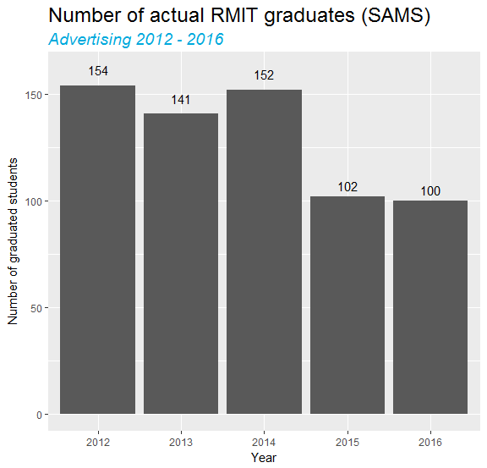
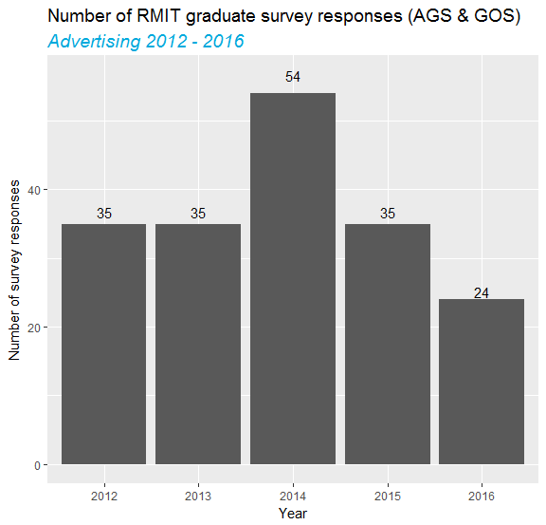
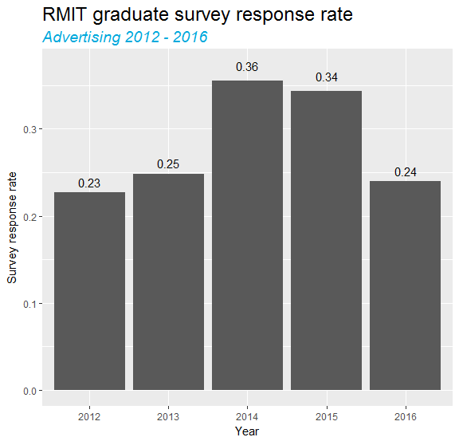
1.1. RMIT graduates vs. RMIT survey respondents
Advertising
Number of RMIT advertising graduates down 1/3 since 2014, response rate consistently low
New survey instrument (GOS) implemented in 2015
Note: survey responses may not be representative of actual graduate population

Slide 29
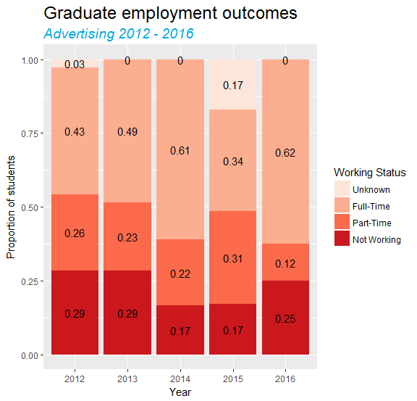
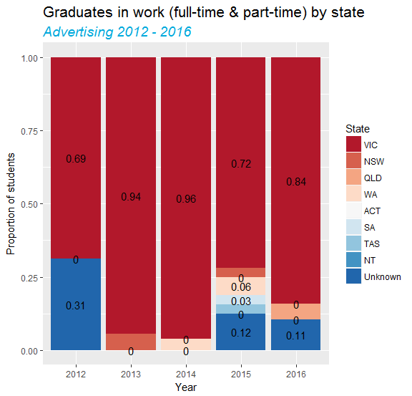
1.2. Are RMIT graduates working? And where?
Advertising
Of those that provided a location, 0.95% (on average) not in VIC across the period
Proportion of full-time employment grew dramatically in 2016 – skewed by small sample size
New survey instrument (GOS) implemented in 2015 – high levels of unknown, missing data

Slide 30
1.3. What roles are RMIT graduates working in?
Advertising
Top 10 most common jobs (from graduate survey responses)
2012 |  | 2014 |  | 2016
Occupation | Count | Occupation | Count | Occupation | Count
account executive | 3 | account coordinator | 3 | advertising specialist | 5
advertising campaign executive | 1 | account manager | 3 | advertising manager | 2
business analyst | 1 | copywriter | 2 | general clerk | 2
business coordinator | 1 | account manager / digital producer | 1 | arts administrator or manager | 1
consultant | 1 | advertising executive | 1 | barista | 1
destination marketing associate | 1 | assistant | 1 | chef | 1
forklift driver | 1 | assistant business engineer | 1 | copywriter | 1
marketing manager | 1 | brand manager | 1 | marketing specialist | 1
media executive | 1 | campaign manager | 1 | public relations professional | 1
planner | 1 | chief editor | 1

Slide 31
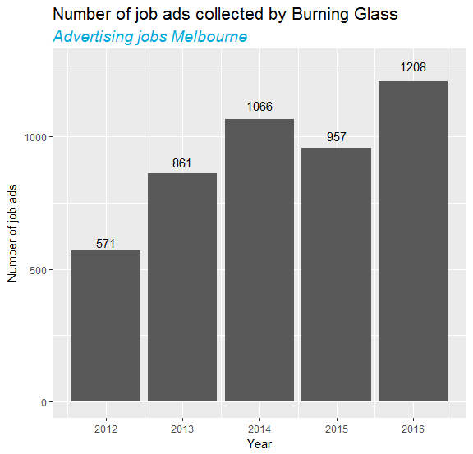
2.1. Supply vs. demand
Advertising
Broad trend appears LESS RMIT advertising graduates competing for SAME number of advertising jobs
Less RMIT advertising students graduating (predominately stay in VIC)
Burning glass total ads for Melbourne (advertising job search) shows reasonably consistent market since 2015

Slide 32
  3.1. ‘Top ten job titles’ 2015 vs. 2016
  Burning Glass: Advertising search
Melbourne
Sydney
Brisbane
Top 10 - 2015
Title | Count
Sales Representatives | 73
Graphic Designer | 71
Marketing Specialist | 48
Artistic Director | 46
Marketing Officer | 32
Marketing Manager | 29
Campaign Or Communications Manager | 20
Administration Officer | 19
Marketing Research | 19
Advertising Manager | 17
Top 10 - 2015
Title | Count
Sales Representatives | 273
Artistic Director | 136
Marketing Specialist | 101
Graphic Designer | 100
Marketing Manager | 78
Digital Design | 44
Campaign Or Communications Manager | 40
Copywriter | 40
Advertising Manager | 37
Finance Manager | 36
Top 10 - 2015
Title | Count
Sales Representatives | 25
Administration Officer | 16
Marketing Manager | 15
Artistic Director | 14
Marketing Specialist | 12
Graphic Designer | 11
Marketing Officer | 9
Administrative Services | 8
Accounts Clerk | 5
Administration Support | 5
Top 10 - 2016
Title | Count
Artistic Director | 94
Sales Representatives | 91
Graphic Designer | 77
Marketing Specialist | 66
Marketing Manager | 56
Campaign Or Communications Manager | 32
Copywriter | 27
Advertising Manager | 17
Communications Officer | 17
Accounts Clerk | 16
Top 10 - 2016
Title | Count
Sales Representatives | 264
Graphic Designer | 196
Marketing Specialist | 173
Artistic Director | 133
Marketing Manager | 117
Campaign Or Communications Manager | 81
Digital Design | 53
Advertising Manager | 48
Accounts Clerk | 44
Copywriter | 44
Top 10 - 2016
Title | Count
Administration Officer | 30
Sales Representatives | 25
Marketing Specialist | 20
Graphic Designer | 15
Communications Officer | 12
Administrative Services | 9
Administration Support | 6
Advertising Manager | 6
Campaign Or Communications Manager | 6
Marketing Manager | 6

Slide 33
  3.2. ‘Top ten software skills’ 2015 vs. 2016
  Burning Glass: Advertising search
Melbourne
Sydney
Brisbane
Top 10 - 2015
Skill | Count
Adobe Photoshop | 128
Adobe Indesign | 91
Adobe Acrobat | 82
Microsoft Office | 72
Microsoft Excel | 62
Microsoft Word | 57
Facebook | 44
Microsoft Powerpoint | 36
Adobe Illustrator | 35
JavaScript | 32
Top 10 - 2015
Skill | Count
Adobe Photoshop | 324
Adobe Indesign | 234
Microsoft Excel | 216
Microsoft Office | 152
Facebook | 133
Adobe Acrobat | 110
Microsoft Powerpoint | 94
JavaScript | 89
Google AdWords | 80
Google Analytics | 78
Top 10 - 2015
Skill | Count
Microsoft Office | 42
Microsoft Excel | 39
Adobe Photoshop | 21
Adobe Indesign | 17
Microsoft Powerpoint | 13
Adobe Acrobat | 11
Google Analytics | 11
Facebook | 8
Google AdWords | 8
JavaScript | 7
Top 10 - 2016
Skill | Count
Adobe Photoshop | 191
Adobe Indesign | 138
Microsoft Excel | 102
Adobe Acrobat | 97
Microsoft Office | 86
Facebook | 82
Google Analytics | 74
Microsoft Powerpoint | 52
Google AdWords | 50
JavaScript | 47
Top 10 - 2016
Skill | Count
Adobe Photoshop | 453
Microsoft Excel | 317
Adobe Indesign | 307
Adobe Acrobat | 252
Microsoft Office | 243
Google Analytics | 195
Facebook | 188
Microsoft Powerpoint | 167
Google AdWords | 155
JavaScript | 136
Top 10 - 2016
Skill | Count
Microsoft Office | 40
Microsoft Excel | 25
Adobe Acrobat | 20
Adobe Photoshop | 18
Adobe Indesign | 16
Google Analytics | 16
Facebook | 14
Google AdWords | 13
Microsoft Word | 13
Microsoft Powerpoint | 12

Slide 34
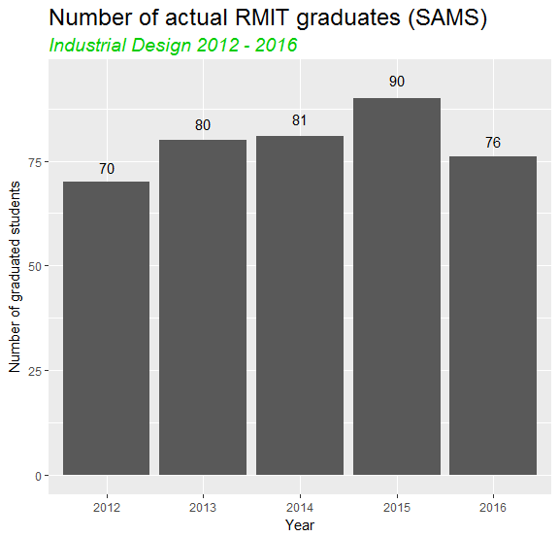
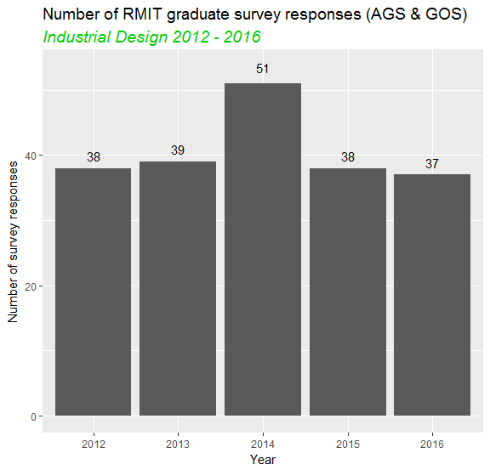
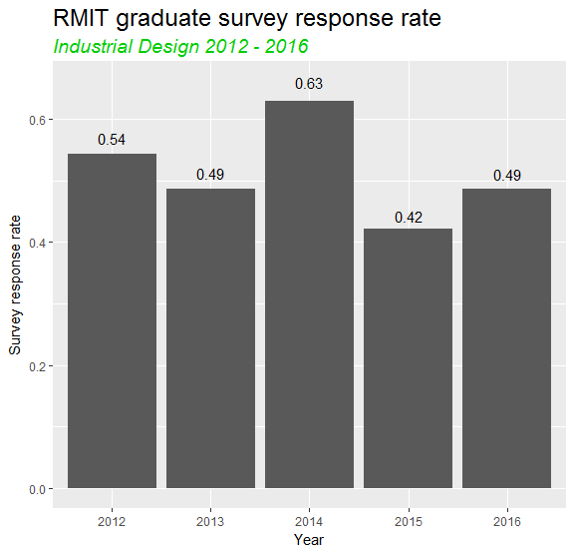
1.1. RMIT graduates vs. RMIT survey respondents
Industrial Design
Number of RMIT industrial design graduates reasonably consistent, besides 2014 response rate also consistent
New survey instrument (GOS) implemented in 2015
Note: survey responses may not be representative of actual graduate population

Slide 35
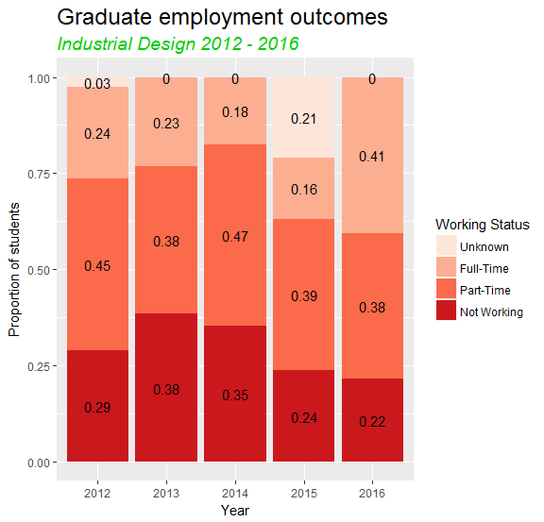
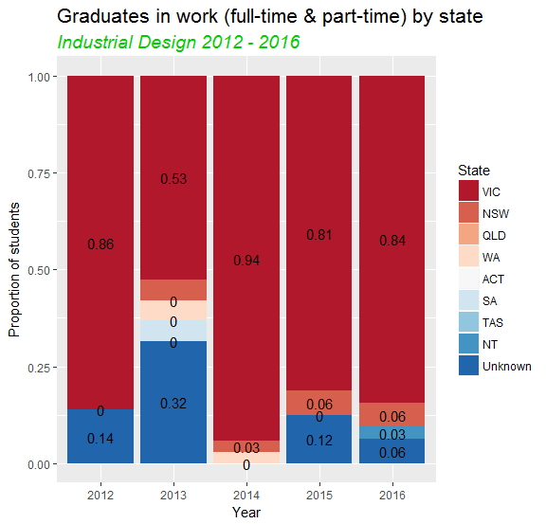
1.2. Are RMIT graduates working? And where?
Industrial Design
Of those that provided a location, 1.31% (on average) not in VIC across the period
Proportion of full-time employment grew dramatically in 2016 – skewed by small sample size
New survey instrument (GOS) implemented in 2015 – high levels of unknown, missing data

Slide 36
1.3. What roles are RMIT graduates working in?
Industrial Design
Top 10 most common jobs (from graduate survey responses)
2012 |  | 2014 |  | 2016
Occupation | Count | Occupation | Count | Occupation | Count
architect | 1 | industrial designer | 2 | industrial designer | 6
creative designer (exterior-interior) | 1 | content collector | 1 | building and engineering technicians | 1
diam displays assembler/prototyper | 1 | design engineer | 1 | fashion designer | 1
graduate industrial designer | 1 | designer | 1 | market research analyst | 1
industrial designer | 1 | furniture and industrial designer | 1 | product assembler | 1
project manager | 1 | hospitality worker | 1 | program or project administrator | 1
retail food staff | 1 | industrial design | 1 | sales and marketing manager | 1
stage designer | 1 | labourer | 1 | specialist managers | 1
 |  |  |  | storeperson | 1
 |  |  |  | web developer | 1

Slide 37
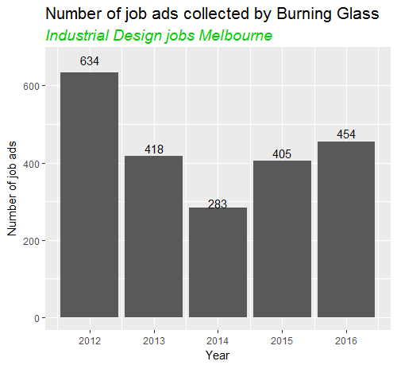
2.1. Supply vs. demand
Industrial Design
Broad trend appears SAME RMIT ind design graduates competing for SAME number of ind design jobs
Broadly similar RMIT ind design students graduating (predominately stay in VIC)
Burning glass total ads for Melbourne (ind design job search) shows reasonably consistent market since 2013 (off year in 2014?)

Slide 38
  3.1. ‘Top ten job titles’ 2015 vs. 2016
  Burning Glass: Industrial Design search
Melbourne
Sydney
Brisbane
Top 10 - 2015
Title | Count
Graphic Designer | 42
Sales Representatives | 33
Mechanical Engineer | 25
Developer Programmer | 16
Industrial Designer | 15
User Experience Designer | 11
Product Design Engineer | 9
Senior Net Technical Lead | 8
Software Engineer | 8
Artistic Director | 6
Top 10 - 2015
Title | Count
Sales Representatives | 61
Graphic Designer | 27
Industrial Designer | 27
User Experience Designer | 23
Mechanical Engineer | 15
Software Developer | 13
Solutions Architect | 12
Project Coordinator | 11
Manager | 10
Software Engineer | 9
Top 10 - 2015
Title | Count
Education Managers | 8
Category Manager | 6
User Experience Designer | 6
Software Engineer | 5
Systems Engineer | 5
Electrical Engineer | 4
Project Coordinator | 4
Site Manager (Construction) | 4
Developer Programmer | 3
Electrician | 3
Top 10 - 2016
Title | Count
Industrial Designer | 38
Graphic Designer | 30
Sales Representatives | 30
User Experience Designer | 28
Mechanical Engineer | 15
Product Design Engineer | 15
Developer Programmer | 10
Manager | 9
Interior Designer | 7
Systems Engineer | 7
Top 10 - 2016
Title | Count
Sales Representatives | 82
Graphic Designer | 60
Industrial Designer | 46
User Experience Designer | 35
Mechanical Engineer | 21
Brand Managers | 19
Software Developer | 19
Marketing Specialist | 12
Software Engineer | 12
Electronics Engineer | 10
Top 10 - 2016
Title | Count
Developer Programmer | 12
Category Manager | 8
Sales Representatives | 6
Mechanical Engineer | 5
Hardware Technician | 4
Buyer | 3
Electronics Engineer | 3
Engineering Manager/ Project Engineer | 3
Technical Writer | 3
University Lecturer | 3

Slide 39
  3.2. ‘Top ten software skills’ 2015 vs. 2016
  Burning Glass: Industrial Design search
Melbourne
Sydney
Brisbane
Top 10 - 2015
Skill | Count
Computer Aided Draughting/Design (CAD) | 62
Adobe Photoshop | 46
Microsoft Excel | 37
Adobe Acrobat | 29
SQL | 29
Microsoft Office | 28
.NET Programming | 27
ASP | 27
Microsoft C# | 27
SQL Server | 27
Top 10 - 2015
Skill | Count
Computer Aided Draughting/Design (CAD) | 69
Adobe Photoshop | 61
Microsoft Excel | 41
JavaScript | 40
SQL | 40
Adobe Indesign | 39
Adobe Acrobat | 36
Microsoft Office | 34
Adobe Illustrator | 28
JAVA | 26
Top 10 - 2015
Skill | Count
Microsoft Excel | 18
Computer Aided Draughting/Design (CAD) | 15
Design Software | 10
Enterprise Resource Planning (ERP) | 9
SQL | 7
Adobe Acrobat | 6
Microsoft Office | 6
Adobe Indesign | 5
Adobe Photoshop | 5
C++ | 5
Top 10 - 2016
Skill | Count
Adobe Photoshop | 62
Computer Aided Draughting/Design (CAD) | 58
Adobe Indesign | 42
Adobe Acrobat | 37
Microsoft Excel | 33
JavaScript | 28
Adobe Illustrator | 24
Visual Design | 24
User Interface (UI) Design | 22
Microsoft Office | 20
Top 10 - 2016
Skill | Count
Adobe Photoshop | 99
Adobe Acrobat | 78
Adobe Indesign | 75
Computer Aided Draughting/Design (CAD) | 71
Microsoft Excel | 58
SQL | 53
JavaScript | 51
Visual Design | 40
Microsoft Office | 36
JAVA | 32
Top 10 - 2016
Skill | Count
SQL | 19
Computer Aided Draughting/Design (CAD) | 16
.NET Programming | 14
Microsoft Excel | 14
Microsoft C# | 10
ASP | 8
JavaScript | 7
Adobe Photoshop | 5
Microsoft Windows | 5
Visual Studio | 5

Slide 40
  4. Appendices

Slide 41
  4.1. ‘Biggest movers’ 2015 vs. 2016 (job titles)
  Burning Glass: All jobs
Melbourne
Sydney
Brisbane
Top 10 biggest increases
Title | 2015 | 2016 | Change | %
Registered Nurse | 1201 | 2062 | 861 | 72%
Sales Representatives | 8256 | 9043 | 787 | 10%
Property Manager | 1220 | 1874 | 654 | 54%
Project Coordinator | 2633 | 3261 | 628 | 24%
Carpenter | 580 | 1163 | 583 | 101%
Marketing Specialist | 901 | 1400 | 499 | 55%
Manager | 817 | 1292 | 475 | 58%
Construction Foreman/Manager | 883 | 1323 | 440 | 50%
Chef | 1347 | 1758 | 411 | 31%
Developer Programmer | 1640 | 2033 | 393 | 24%
Top 10 biggest increases
Title | 2015 | 2016 | Change | %
Sales Representatives | 15625 | 17503 | 1878 | 12%
Project Coordinator | 4837 | 6070 | 1233 | 25%
Construction Foreman/Manager | 2089 | 3314 | 1225 | 59%
Civil Engineer | 1005 | 2188 | 1183 | 118%
Registered Nurse | 1696 | 2861 | 1165 | 69%
Qualified Accountant | 2752 | 3898 | 1146 | 42%
Developer Programmer | 2531 | 3623 | 1092 | 43%
Retail Manager | 3611 | 4622 | 1011 | 28%
Electrician | 784 | 1650 | 866 | 110%
Executive Assistant | 2085 | 2936 | 851 | 41%
Top 10 biggest increases
Title | 2015 | 2016 | Change | %
Registered Nurse | 791 | 1051 | 260 | 33%
Construction Foreman/Manager | 695 | 916 | 221 | 32%
Property Manager | 661 | 872 | 211 | 32%
Sales Representative | 530 | 738 | 208 | 39%
Project Coordinator | 1018 | 1222 | 204 | 20%
Healthcare Manager | 283 | 441 | 158 | 56%
Contracts Administrator | 374 | 524 | 150 | 40%
General Medical Practitioner | 461 | 606 | 145 | 31%
Solicitor | 598 | 719 | 121 | 20%
Structural Design | 185 | 303 | 118 | 64%
Top 10 biggest decreases
Title | 2015 | 2016 | Change | %
Secondary School Teacher | 396 | 222 | -174 | -44%
Technology Consultant | 557 | 388 | -169 | -30%
Financial Investment Adviser | 977 | 818 | -159 | -16%
Accounts Officer | 407 | 322 | -85 | -21%
Accounts Clerk | 1404 | 1325 | -79 | -6%
Bookkeeper | 516 | 443 | -73 | -14%
Bank Worker | 273 | 202 | -71 | -26%
Taxation Accountant | 319 | 252 | -67 | -21%
Travel Consultant | 433 | 379 | -54 | -12%
Retail Sales | 1352 | 1301 | -51 | -4%
Top 10 biggest decreases
Title | 2015 | 2016 | Change | %
Travel Consultant | 885 | 779 | -106 | -12%
Waiter | 518 | 445 | -73 | -14%
Telesales | 470 | 435 | -35 | -7%
Management Accountant | 1218 | 1187 | -31 | -3%
Finance Manager | 3080 | 3066 | -14 | 0%
Medical Receptionist | 460 | 452 | -8 | -2%
Merchandiser | 535 | 533 | -2 | 0%
Top 10 biggest decreases
Title | 2015 | 2016 | Change | %
Sales Representatives | 3389 | 3134 | -255 | -8%
Qualified Accountant | 1352 | 1136 | -216 | -16%
Receptionist | 896 | 688 | -208 | -23%
Retail Manager | 1589 | 1389 | -200 | -13%
Taxation Accountant | 407 | 229 | -178 | -44%
Travel Consultant | 408 | 251 | -157 | -38%
Administrative Services | 629 | 473 | -156 | -25%
Accounts Clerk | 586 | 434 | -152 | -26%
Sales Assistant | 820 | 673 | -147 | -18%
Financial Analyst | 686 | 550 | -136 | -20%

Slide 42
  4.1. ‘Biggest movers’ 2015 vs. 2016 (job titles)
  Burning Glass: Engineering search
Melbourne
Sydney
Brisbane
Top 10 biggest increases
Title | 2015 | 2016 | Change | %
Civil Engineer | 393 | 606 | 213 | 54%
Engineering Manager/ Project Engineer | 170 | 263 | 93 | 55%
Structural Drafter | 24 | 93 | 69 | 288%
Engineering Manager | 108 | 166 | 58 | 54%
Electrical Engineer | 264 | 322 | 58 | 22%
Structural Design | 151 | 207 | 56 | 37%
Electrical Engineering Technician | 88 | 139 | 51 | 58%
Civil Draftsperson | 85 | 135 | 50 | 59%
Revit Architectural Drafter | 208 | 258 | 50 | 24%
Surveyor | 178 | 221 | 43 | 24%
Top 10 biggest increases
Title | 2015 | 2016 | Change | %
Civil Engineer | 1003 | 2183 | 1180 | 118%
Electrical Engineer | 457 | 840 | 383 | 84%
Engineering Manager/ Project Engineer | 477 | 824 | 347 | 73%
Mechanical Engineer | 339 | 640 | 301 | 89%
Structural Design | 506 | 776 | 270 | 53%
Civil Draftsperson | 209 | 391 | 182 | 87%
Structural Drafter | 225 | 400 | 175 | 78%
Civil Engineering Draftsperson | 210 | 375 | 165 | 79%
Surveyor | 284 | 401 | 117 | 41%
Revit Architectural Drafter | 189 | 302 | 113 | 60%
Top 10 biggest increases
Title | 2015 | 2016 | Change | %
Structural Design | 185 | 303 | 118 | 64%
Civil Engineer | 333 | 417 | 84 | 25%
Civil Engineering Draftsperson | 123 | 203 | 80 | 65%
Electrical Engineer | 179 | 237 | 58 | 32%
Engineering Manager/ Project Engineer | 120 | 177 | 57 | 48%
Cad Draftsperson | 12 | 36 | 24 | 200%
Engineering Manager | 53 | 76 | 23 | 43%
Civil Draftsperson | 56 | 76 | 20 | 36%
Architectural Draftsperson | 17 | 36 | 19 | 112%
Drafter (Other) | 9 | 27 | 18 | 200%
Top 10 biggest decreases
Title | 2015 | 2016 | Change | %
Civil Engineering Draftsperson | 58 | 44 | -14 | -24%
Drafting Manager | 20 | 10 | -10 | -50%
Civil Design | 9 | 3 | -6 | -67%
Instrumentation Engineer | 10 | 5 | -5 | -50%
Chemical Engineer | 10 | 6 | -4 | -40%
Fire Services Engineer | 17 | 14 | -3 | -18%
Rf Engineer | 11 | 8 | -3 | -27%
Materials Engineer | 9 | 6 | -3 | -33%
Engineering Technician | 6 | 3 | -3 | -50%
Aeronautical Engineer | 11 | 9 | -2 | -18%
Top 10 biggest decreases
Title | 2015 | 2016 | Change | %
Industrial Engineer | 61 | 43 | -18 | -30%
Architectural Technician | 171 | 158 | -13 | -8%
Drafter (Other) | 28 | 18 | -10 | -36%
Aeronautical Engineer | 14 | 5 | -9 | -64%
Cadastral Surveyor | 11 | 5 | -6 | -55%
Rf Engineer | 30 | 25 | -5 | -17%
Cad Drafter | 14 | 10 | -4 | -29%
Field Engineer | 13 | 9 | -4 | -31%
Materials Engineer | 9 | 5 | -4 | -44%
Design Engineer | 21 | 18 | -3 | -14%
Top 10 biggest decreases
Title | 2015 | 2016 | Change | %
Mechanical Engineer | 212 | 190 | -22 | -10%
Revit Architectural Drafter | 73 | 54 | -19 | -26%
Oil And Gas Engineer | 26 | 7 | -19 | -73%
Mechanical Engineering Draftsperson | 32 | 19 | -13 | -41%
Production Or Plant Engineer | 26 | 15 | -11 | -42%
Health And Safety Advisor | 24 | 13 | -11 | -46%
Mining Engineer | 30 | 23 | -7 | -23%
Engineering Professionals | 14 | 7 | -7 | -50%
Hardware Technician | 12 | 5 | -7 | -58%
Structural Drafter | 59 | 54 | -5 | -8%

Slide 43
  4.2. ‘Biggest movers’ 2015 vs. 2016 (software skills)
  Burning Glass: Engineering search
Melbourne
Sydney
Brisbane
Top 10 biggest increases
Skill | 2015 | 2016 | Change | %
Computer Aided Draughting/Design (CAD) | 368 | 629 | 261 | 71%
Revit | 379 | 606 | 227 | 60%
Microstation | 89 | 209 | 120 | 135%
Microsoft Office | 87 | 181 | 94 | 108%
Microsoft Excel | 116 | 152 | 36 | 31%
Civil 3D | 32 | 65 | 33 | 103%
Selenium | 60 | 89 | 29 | 48%
Microsoft Windows | 52 | 79 | 27 | 52%
Design Software | 46 | 68 | 22 | 48%
Microsoft Project | 10 | 31 | 21 | 210%
Top 10 biggest increases
Skill | 2015 | 2016 | Change | %
Revit | 628 | 1093 | 465 | 74%
Computer Aided Draughting/Design (CAD) | 618 | 974 | 356 | 58%
Microsoft Excel | 207 | 330 | 123 | 59%
Microsoft Office | 187 | 308 | 121 | 65%
Civil 3D | 241 | 331 | 90 | 37%
JAVA | 100 | 172 | 72 | 72%
LINUX | 111 | 177 | 66 | 59%
Python | 101 | 159 | 58 | 57%
Microsoft Windows | 93 | 146 | 53 | 57%
Microsoft Powerpoint | 39 | 83 | 44 | 113%
Top 10 biggest increases
Skill | 2015 | 2016 | Change | %
Computer Aided Draughting/Design (CAD) | 238 | 333 | 95 | 40%
Microsoft Office | 80 | 134 | 54 | 68%
Design Software | 45 | 87 | 42 | 93%
Microsoft Excel | 67 | 94 | 27 | 40%
JAVA | 8 | 30 | 22 | 275%
Civil 3D | 18 | 40 | 22 | 122%
Revit | 206 | 226 | 20 | 10%
Geographic Information System (GIS) | 13 | 27 | 14 | 108%
Microstation | 37 | 50 | 13 | 35%
Oracle | 1 | 11 | 10 | 1000%
Top 10 biggest decreases
Skill | 2015 | 2016 | Change | %
Visual Basic | 19 | 5 | -14 | -74%
Enterprise Resource Planning (ERP) | 28 | 16 | -12 | -43%
Lotus Applications | 11 | 1 | -10 | -91%
Facebook | 33 | 24 | -9 | -27%
UNIX | 33 | 24 | -9 | -27%
NASTRAN | 10 | 1 | -9 | -90%
Citrix | 16 | 8 | -8 | -50%
Middleware | 9 | 2 | -7 | -78%
SAP | 36 | 30 | -6 | -17%
Apache Webserver | 15 | 9 | -6 | -40%
Top 10 biggest decreases
Skill | 2015 | 2016 | Change | %
Autodesk | 63 | 35 | -28 | -44%
Facebook | 83 | 63 | -20 | -24%
JUnit | 24 | 8 | -16 | -67%
Hyper-V | 19 | 12 | -7 | -37%
AutoTrack | 12 | 6 | -6 | -50%
Adobe Acrobat | 36 | 31 | -5 | -14%
SQL Server | 16 | 11 | -5 | -31%
Customer Relationship Management (CRM) | 10 | 5 | -5 | -50%
Shell Scripting | 21 | 17 | -4 | -19%
Inroads | 17 | 13 | -4 | -24%
Top 10 biggest decreases
Skill | 2015 | 2016 | Change | %
Facebook | 21 | 9 | -12 | -57%
Word Processing | 15 | 6 | -9 | -60%
Engineering Software | 19 | 12 | -7 | -37%
CADD | 15 | 9 | -6 | -40%
Adobe Acrobat | 7 | 2 | -5 | -71%
STAAD | 6 | 1 | -5 | -83%
Bash | 6 | 2 | -4 | -67%
Chef | 6 | 2 | -4 | -67%
Microsoft Windows | 22 | 19 | -3 | -14%
PERL | 8 | 5 | -3 | -38%

Slide 44
  4.1. ‘Biggest movers’ 2015 vs. 2016 (job titles)
  Burning Glass: Journalism search
Melbourne
Sydney
Brisbane
Top 10 biggest increases
Title | 2015 | 2016 | Change | %
Communications Officer | 64 | 106 | 42 | 66%
Sales Representatives | 13 | 35 | 22 | 169%
Journalist | 19 | 38 | 19 | 100%
Copywriter | 13 | 27 | 14 | 108%
Public Relations Officer | 3 | 16 | 13 | 433%
Content Producer | 6 | 19 | 13 | 217%
Public Relations Professional | 27 | 39 | 12 | 44%
Campaign Or Communications Manager | 12 | 23 | 11 | 92%
Marketing Intern | 6 | 15 | 9 | 150%
Intern | 9 | 17 | 8 | 89%
Top 10 biggest increases
Title | 2015 | 2016 | Change | %
Journalist | 57 | 140 | 83 | 146%
Campaign Or Communications Manager | 43 | 78 | 35 | 81%
Communications Officer | 90 | 124 | 34 | 38%
Marketing Specialist | 34 | 67 | 33 | 97%
Graphic Designer | 9 | 39 | 30 | 333%
Marketing Manager | 11 | 33 | 22 | 200%
Public Relations Officer | 8 | 28 | 20 | 250%
Content Producer | 14 | 32 | 18 | 129%
Accounts Clerk | 5 | 21 | 16 | 320%
News Editor | 7 | 21 | 14 | 200%
Top 10 biggest increases
Title | 2015 | 2016 | Change | %
Public Relations Professional | 7 | 22 | 15 | 214%
Marketing Specialist | 3 | 14 | 11 | 367%
Communications Officer | 51 | 59 | 8 | 16%
Marketing Manager | 3 | 8 | 5 | 167%
Social Media Marketing | 1 | 5 | 4 | 400%
Intern | 2 | 5 | 3 | 150%
Copywriter | 5 | 8 | 3 | 60%
Communications Manager | 1 | 3 | 2 | 200%
University Lecturer | 1 | 3 | 2 | 200%
Media Producer (Excluding Video) | 2 | 4 | 2 | 100%
Top 10 biggest decreases
Title | 2015 | 2016 | Change | %
Communications Manager | 7 | 2 | -5 | -71%
Marketing Research | 6 | 2 | -4 | -67%
University Lecturer | 10 | 8 | -2 | -20%
Advertising Manager | 4 | 2 | -2 | -50%
Public Relations Manager | 6 | 5 | -1 | -17%
Administration Officer | 3 | 2 | -1 | -33%
Business Manager | 2 | 1 | -1 | -50%
Top 10 biggest decreases
Title | 2015 | 2016 | Change | %
Public Relations Professional | 46 | 32 | -14 | -30%
Ict Project Manager | 14 | 5 | -9 | -64%
Social Media Marketing | 8 | 3 | -5 | -63%
Marketing Research | 12 | 8 | -4 | -33%
Sales Manager | 10 | 6 | -4 | -40%
Project Coordinator | 5 | 2 | -3 | -60%
Developer Programmer | 5 | 3 | -2 | -40%
Finance Manager | 4 | 2 | -2 | -50%
Front End Developer | 4 | 2 | -2 | -50%
Hospitality Manager | 4 | 2 | -2 | -50%
Top 10 biggest decreases
Title | 2015 | 2016 | Change | %
Campaign Or Communications Manager | 9 | 5 | -4 | -44%
Reporter | 5 | 1 | -4 | -80%
Writer | 4 | 1 | -3 | -75%
Journalist | 17 | 16 | -1 | -6%
Graphic Designer | 11 | 10 | -1 | -9%
Content Producer | 3 | 2 | -1 | -33%
Marketing Officer | 3 | 2 | -1 | -33%
News Producer | 2 | 1 | -1 | -50%
Web Administrator | 2 | 1 | -1 | -50%

Slide 45
  4.2. ‘Biggest movers’ 2015 vs. 2016 (software skills)
  Burning Glass: Journalism search
Melbourne
Sydney
Brisbane
Top 10 biggest increases
Skill | 2015 | 2016 | Change | %
Microsoft Office | 36 | 70 | 34 | 94%
Social Media Platforms | 17 | 49 | 32 | 188%
Microsoft Excel | 28 | 42 | 14 | 50%
Facebook | 38 | 52 | 14 | 37%
Microsoft Sharepoint | 3 | 14 | 11 | 367%
Adobe Indesign | 14 | 25 | 11 | 79%
Adobe Acrobat | 22 | 33 | 11 | 50%
Oracle | 1 | 11 | 10 | 1000%
Microsoft Access | 1 | 8 | 7 | 700%
SQL | 1 | 8 | 7 | 700%
Top 10 biggest increases
Skill | 2015 | 2016 | Change | %
Microsoft Office | 59 | 121 | 62 | 105%
Adobe Photoshop | 85 | 137 | 52 | 61%
Microsoft Powerpoint | 36 | 70 | 34 | 94%
Social Media Platforms | 75 | 108 | 33 | 44%
Facebook | 95 | 128 | 33 | 35%
Adobe Acrobat | 29 | 55 | 26 | 90%
Adobe Indesign | 42 | 64 | 22 | 52%
LinkedIn | 37 | 56 | 19 | 51%
Google Analytics | 23 | 39 | 16 | 70%
Pinterest | 4 | 18 | 14 | 350%
Top 10 biggest increases
Skill | 2015 | 2016 | Change | %
Google Analytics | 3 | 24 | 21 | 700%
Social Media Platforms | 15 | 35 | 20 | 133%
Facebook | 12 | 31 | 19 | 158%
LinkedIn | 2 | 17 | 15 | 750%
Google AdWords | 1 | 11 | 10 | 1000%
Microsoft Office | 27 | 36 | 9 | 33%
Adobe Photoshop | 14 | 21 | 7 | 50%
Adobe Acrobat | 18 | 25 | 7 | 39%
Word Processing | 1 | 3 | 2 | 200%
Drupal | 2 | 4 | 2 | 100%
Top 10 biggest decreases
Skill | 2015 | 2016 | Change | %
Hootsuite | 9 | 1 | -8 | -89%
Word Processing | 13 | 8 | -5 | -38%
Adobe Photoshop | 37 | 34 | -3 | -8%
Microsoft Publisher | 7 | 4 | -3 | -43%
MailChimp | 4 | 1 | -3 | -75%
WordPress | 7 | 5 | -2 | -29%
Web Analytics | 6 | 4 | -2 | -33%
HyperText Markup Language | 3 | 1 | -2 | -67%
Adobe Illustrator | 3 | 2 | -1 | -33%
Adobe Aftereffects | 2 | 1 | -1 | -50%
Top 10 biggest decreases
Skill | 2015 | 2016 | Change | %
Hypertext Preprocessor (PHP) | 12 | 2 | -10 | -83%
WordPress | 10 | 4 | -6 | -60%
Microsoft Sharepoint | 17 | 13 | -4 | -24%
Microsoft Windows | 12 | 8 | -4 | -33%
JavaScript | 12 | 9 | -3 | -25%
Web Analytics | 11 | 8 | -3 | -27%
Microsoft C# | 4 | 1 | -3 | -75%
Hootsuite | 7 | 5 | -2 | -29%
Final Cut Pro | 11 | 10 | -1 | -9%
JAVA | 11 | 10 | -1 | -9%
Top 10 biggest decreases
Skill | 2015 | 2016 | Change | %
Microsoft Excel | 18 | 8 | -10 | -56%
Microsoft Word | 9 | 1 | -8 | -89%
Microsoft Powerpoint | 9 | 5 | -4 | -44%
Microsoft Publisher | 3 | 1 | -2 | -67%
Microsoft Sharepoint | 18 | 17 | -1 | -6%
Adobe Illustrator | 3 | 2 | -1 | -33%
Hootsuite | 2 | 1 | -1 | -50%

Slide 46
  4.1. ‘Biggest movers’ 2015 vs. 2016 (job titles)
  Burning Glass: Advertising search
Melbourne
Sydney
Brisbane
Top 10 biggest increases
Title | 2015 | 2016 | Change | %
Artistic Director | 46 | 94 | 48 | 104%
Marketing Manager | 29 | 56 | 27 | 93%
Marketing Specialist | 48 | 66 | 18 | 38%
Sales Representatives | 73 | 91 | 18 | 25%
Copywriter | 14 | 27 | 13 | 93%
Accounts Clerk | 4 | 16 | 12 | 300%
Campaign Or Communications Manager | 20 | 32 | 12 | 60%
Communications Officer | 7 | 17 | 10 | 143%
Market Research Analyst | 2 | 10 | 8 | 400%
Ict Project Manager | 6 | 13 | 7 | 117%
Top 10 biggest increases
Title | 2015 | 2016 | Change | %
Graphic Designer | 100 | 196 | 96 | 96%
Marketing Specialist | 101 | 173 | 72 | 71%
Campaign Or Communications Manager | 40 | 81 | 41 | 103%
Marketing Manager | 78 | 117 | 39 | 50%
Recruitment Consultant | 13 | 33 | 20 | 154%
Ict Project Manager | 13 | 31 | 18 | 138%
Sales Assistant | 9 | 23 | 14 | 156%
Accounts Clerk | 30 | 44 | 14 | 47%
Administration Officer | 7 | 18 | 11 | 157%
Market Research Analyst | 8 | 19 | 11 | 138%
Top 10 biggest increases
Title | 2015 | 2016 | Change | %
Administration Officer | 16 | 30 | 14 | 88%
Communications Officer | 4 | 12 | 8 | 200%
Marketing Specialist | 12 | 20 | 8 | 67%
Advertising Manager | 2 | 6 | 4 | 200%
Graphic Designer | 11 | 15 | 4 | 36%
Marketing Research | 1 | 4 | 3 | 300%
Campaign Or Communications Manager | 3 | 6 | 3 | 100%
Brand Managers | 1 | 2 | 1 | 100%
Health And Safety Advisor | 1 | 2 | 1 | 100%
Medical And Pharmaceutical Sales | 1 | 2 | 1 | 100%
Top 10 biggest decreases
Title | 2015 | 2016 | Change | %
Marketing Officer | 32 | 15 | -17 | -53%
Specialist Physician (General Medicine) | 17 | 2 | -15 | -88%
Administration Officer | 19 | 6 | -13 | -68%
Marketing Research | 19 | 7 | -12 | -63%
Media Producer (Excluding Video) | 16 | 9 | -7 | -44%
Event Organiser | 10 | 3 | -7 | -70%
Advertising Consultant | 8 | 3 | -5 | -63%
Procurement Officer | 6 | 2 | -4 | -67%
Retail Sales | 6 | 2 | -4 | -67%
Sales Administrator | 6 | 2 | -4 | -67%
Top 10 biggest decreases
Title | 2015 | 2016 | Change | %
Finance Manager | 36 | 17 | -19 | -53%
Brand Managers | 16 | 5 | -11 | -69%
Sales Representatives | 273 | 264 | -9 | -3%
Operations Specialist | 11 | 2 | -9 | -82%
Recruiter | 9 | 2 | -7 | -78%
Front End Developer | 12 | 6 | -6 | -50%
Personal Assistant | 9 | 5 | -4 | -44%
Project Coordinator | 7 | 3 | -4 | -57%
Artistic Director | 136 | 133 | -3 | -2%
Receptionist | 9 | 6 | -3 | -33%
Top 10 biggest decreases
Title | 2015 | 2016 | Change | %
Marketing Manager | 15 | 6 | -9 | -60%
Artistic Director | 14 | 5 | -9 | -64%
Marketing Officer | 9 | 3 | -6 | -67%
Advertising Specialist | 5 | 1 | -4 | -80%
Sales Assistant | 4 | 1 | -3 | -75%
Market Research Analyst | 5 | 3 | -2 | -40%
Maintenance Technician | 3 | 1 | -2 | -67%
Service Advisor | 3 | 1 | -2 | -67%
Sonographer | 3 | 1 | -2 | -67%
Telesales | 3 | 1 | -2 | -67%

Slide 47
  4.2. ‘Biggest movers’ 2015 vs. 2016 (software skills)
  Burning Glass: Advertising search
Melbourne
Sydney
Brisbane
Top 10 biggest increases
Skill | 2015 | 2016 | Change | %
Adobe Photoshop | 128 | 191 | 63 | 49%
Google Analytics | 24 | 74 | 50 | 208%
Adobe Indesign | 91 | 138 | 47 | 52%
Microsoft Excel | 62 | 102 | 40 | 65%
Facebook | 44 | 82 | 38 | 86%
Social Media Platforms | 8 | 44 | 36 | 450%
Google AdWords | 29 | 50 | 21 | 72%
Adobe Aftereffects | 2 | 20 | 18 | 900%
Microsoft Powerpoint | 36 | 52 | 16 | 44%
Hypertext Preprocessor (PHP) | 6 | 21 | 15 | 250%
Top 10 biggest increases
Skill | 2015 | 2016 | Change | %
Adobe Acrobat | 110 | 252 | 142 | 129%
Adobe Photoshop | 324 | 453 | 129 | 40%
Google Analytics | 78 | 195 | 117 | 150%
Microsoft Excel | 216 | 317 | 101 | 47%
Microsoft Office | 152 | 243 | 91 | 60%
HTML5 | 38 | 121 | 83 | 218%
Google AdWords | 80 | 155 | 75 | 94%
Microsoft Powerpoint | 94 | 167 | 73 | 78%
Adobe Indesign | 234 | 307 | 73 | 31%
Facebook | 133 | 188 | 55 | 41%
Top 10 biggest increases
Skill | 2015 | 2016 | Change | %
Adobe Acrobat | 11 | 20 | 9 | 82%
Microsoft Sharepoint | 1 | 8 | 7 | 700%
Microsoft Word | 7 | 13 | 6 | 86%
Facebook | 8 | 14 | 6 | 75%
Google AdWords | 8 | 13 | 5 | 63%
Google Analytics | 11 | 16 | 5 | 45%
Microsoft Windows | 2 | 6 | 4 | 200%
SAP | 2 | 6 | 4 | 200%
WordPress | 1 | 3 | 2 | 200%
Customer Relationship Management (CRM) | 3 | 5 | 2 | 67%
Top 10 biggest decreases
Skill | 2015 | 2016 | Change | %
Microsoft Word | 57 | 36 | -21 | -37%
User Interface (UI) Design | 25 | 21 | -4 | -16%
C++ | 7 | 4 | -3 | -43%
Git | 6 | 3 | -3 | -50%
Graphical User Interface (GUI) | 5 | 2 | -3 | -60%
Graphics Software | 4 | 1 | -3 | -75%
SAS | 5 | 4 | -1 | -20%
Webtrends | 4 | 3 | -1 | -25%
Cognos Impromptu | 2 | 1 | -1 | -50%
Fund Accountancy | 2 | 1 | -1 | -50%
Top 10 biggest decreases
Skill | 2015 | 2016 | Change | %
AJAX | 19 | 4 | -15 | -79%
Actionscript | 16 | 2 | -14 | -88%
JSON | 11 | 2 | -9 | -82%
Extensible Markup Language (XML) | 11 | 5 | -6 | -55%
Git | 13 | 8 | -5 | -38%
QuarkXPress | 8 | 3 | -5 | -63%
Final Cut Pro | 9 | 5 | -4 | -44%
Usability Testing | 6 | 2 | -4 | -67%
Oracle | 9 | 6 | -3 | -33%
jQuery | 20 | 18 | -2 | -10%
Top 10 biggest decreases
Skill | 2015 | 2016 | Change | %
Microsoft Excel | 39 | 25 | -14 | -36%
JavaScript | 7 | 3 | -4 | -57%
Adobe Photoshop | 21 | 18 | -3 | -14%
DoubleClick | 4 | 1 | -3 | -75%
HyperText Markup Language | 4 | 1 | -3 | -75%
Microsoft Office | 42 | 40 | -2 | -5%
Adobe Indesign | 17 | 16 | -1 | -6%
Microsoft Powerpoint | 13 | 12 | -1 | -8%
Enterprise Resource Planning (ERP) | 4 | 3 | -1 | -25%

Slide 48
  4.1. ‘Biggest movers’ 2015 vs. 2016 (job titles)
  Burning Glass: Communication Design search
Melbourne
Sydney
Brisbane
Top 10 biggest increases
Title | 2015 | 2016 | Change | %
Marketing Specialist | 366 | 631 | 265 | 72%
Communications Officer | 209 | 375 | 166 | 79%
Graphic Designer | 208 | 316 | 108 | 52%
Marketing Manager | 346 | 453 | 107 | 31%
Campaign Or Communications Manager | 137 | 214 | 77 | 56%
User Experience Designer | 100 | 177 | 77 | 77%
Sales Representatives | 551 | 617 | 66 | 12%
Project Coordinator | 85 | 135 | 50 | 59%
Marketing Intern | 31 | 72 | 41 | 132%
Intern | 43 | 80 | 37 | 86%
Top 10 biggest increases
Title | 2015 | 2016 | Change | %
Marketing Specialist | 891 | 1225 | 334 | 37%
Marketing Manager | 767 | 1087 | 320 | 42%
Graphic Designer | 475 | 766 | 291 | 61%
Sales Representatives | 1454 | 1619 | 165 | 11%
Campaign Or Communications Manager | 359 | 523 | 164 | 46%
Accounts Clerk | 176 | 273 | 97 | 55%
Interior Designer | 91 | 184 | 93 | 102%
Communications Officer | 337 | 424 | 87 | 26%
User Experience Designer | 183 | 264 | 81 | 44%
Ict Project Manager | 257 | 331 | 74 | 29%
Top 10 biggest increases
Title | 2015 | 2016 | Change | %
Marketing Specialist | 111 | 182 | 71 | 64%
Communications Officer | 82 | 133 | 51 | 62%
Marketing Manager | 80 | 131 | 51 | 64%
Civil Engineering Draftsperson | 29 | 68 | 39 | 134%
Public Relations Professional | 33 | 59 | 26 | 79%
Construction Foreman/Manager | 12 | 38 | 26 | 217%
Electrical Engineer | 21 | 43 | 22 | 105%
Social Media Marketing | 15 | 31 | 16 | 107%
Landscape Architect | 14 | 28 | 14 | 100%
Solutions Architect | 28 | 41 | 13 | 46%
Top 10 biggest decreases
Title | 2015 | 2016 | Change | %
Software Developer | 83 | 47 | -36 | -43%
Developer Programmer | 149 | 118 | -31 | -21%
Mechanical Engineer | 79 | 52 | -27 | -34%
Recruitment Consultant | 54 | 37 | -17 | -31%
Technology Consultant | 27 | 11 | -16 | -59%
Industrial Engineer | 27 | 12 | -15 | -56%
Retail Sales | 25 | 11 | -14 | -56%
Application Developer | 37 | 25 | -12 | -32%
Front End Developer | 54 | 44 | -10 | -19%
Web Designer | 48 | 38 | -10 | -21%
Top 10 biggest decreases
Title | 2015 | 2016 | Change | %
Application Developer | 81 | 58 | -23 | -28%
Recruiter | 87 | 72 | -15 | -17%
Business Analyst | 115 | 101 | -14 | -12%
Finance Manager | 52 | 41 | -11 | -21%
Geotechnical Engineer | 24 | 13 | -11 | -46%
Production Coordinator | 24 | 13 | -11 | -46%
Public Affairs Officer | 32 | 25 | -7 | -22%
Financial Analyst | 32 | 26 | -6 | -19%
Retail Sales | 25 | 19 | -6 | -24%
Public Relations Manager | 95 | 91 | -4 | -4%
Top 10 biggest decreases
Title | 2015 | 2016 | Change | %
Developer Programmer | 75 | 54 | -21 | -28%
Business Manager | 31 | 15 | -16 | -52%
Marketing Officer | 37 | 25 | -12 | -32%
Sales Representatives | 138 | 128 | -10 | -7%
Web Developer | 31 | 21 | -10 | -32%
Web Designer | 19 | 9 | -10 | -53%
Business Development Manager | 13 | 3 | -10 | -77%
Accounts Clerk | 27 | 18 | -9 | -33%
Application Developer | 19 | 11 | -8 | -42%
Systems Engineer | 24 | 18 | -6 | -25%

Slide 49
  4.2. ‘Biggest movers’ 2015 vs. 2016 (software skills)
  Burning Glass: Communication Design search
Melbourne
Sydney
Brisbane
Top 10 biggest increases
Skill | 2015 | 2016 | Change | %
Social Media Platforms | 255 | 526 | 271 | 106%
Microsoft Office | 734 | 980 | 246 | 34%
Computer Aided Draughting/Design (CAD) | 396 | 642 | 246 | 62%
Adobe Acrobat | 433 | 669 | 236 | 55%
Adobe Photoshop | 672 | 894 | 222 | 33%
Revit | 248 | 470 | 222 | 90%
Microsoft Excel | 765 | 934 | 169 | 22%
Adobe Indesign | 400 | 565 | 165 | 41%
Google Analytics | 242 | 387 | 145 | 60%
Microsoft Windows | 187 | 294 | 107 | 57%
Top 10 biggest increases
Skill | 2015 | 2016 | Change | %
Adobe Photoshop | 1307 | 2062 | 755 | 58%
Microsoft Office | 1444 | 2128 | 684 | 47%
Microsoft Excel | 1736 | 2346 | 610 | 35%
Adobe Indesign | 752 | 1309 | 557 | 74%
Adobe Acrobat | 681 | 1180 | 499 | 73%
Social Media Platforms | 649 | 1094 | 445 | 69%
Microsoft Powerpoint | 887 | 1320 | 433 | 49%
Google Analytics | 562 | 987 | 425 | 76%
Facebook | 1352 | 1726 | 374 | 28%
Revit | 308 | 599 | 291 | 94%
Top 10 biggest increases
Skill | 2015 | 2016 | Change | %
Microsoft Office | 256 | 336 | 80 | 31%
Facebook | 116 | 195 | 79 | 68%
Social Media Platforms | 85 | 163 | 78 | 92%
Microsoft Windows | 63 | 136 | 73 | 116%
Revit | 82 | 144 | 62 | 76%
Adobe Indesign | 104 | 156 | 52 | 50%
LinkedIn | 44 | 96 | 52 | 118%
Microsoft Sharepoint | 81 | 131 | 50 | 62%
Google Analytics | 62 | 112 | 50 | 81%
Microsoft Word | 44 | 93 | 49 | 111%
Top 10 biggest decreases
Skill | 2015 | 2016 | Change | %
JavaScript | 721 | 516 | -205 | -28%
AngularJS | 267 | 69 | -198 | -74%
Django | 201 | 6 | -195 | -97%
Git | 264 | 82 | -182 | -69%
Python | 265 | 86 | -179 | -68%
Vimeo | 163 | 9 | -154 | -94%
LinkedIn | 306 | 258 | -48 | -16%
.NET Programming | 150 | 113 | -37 | -25%
jQuery | 183 | 155 | -28 | -15%
Extensible Markup Language | 111 | 92 | -19 | -17%
Top 10 biggest decreases
Skill | 2015 | 2016 | Change | %
SPSS | 116 | 54 | -62 | -53%
Tumblr | 61 | 38 | -23 | -38%
Actionscript | 41 | 18 | -23 | -56%
Sybase | 38 | 23 | -15 | -39%
Extensible Markup Language | 250 | 236 | -14 | -6%
Autodesk | 41 | 30 | -11 | -27%
Transact-SQL | 57 | 49 | -8 | -14%
MongoDB | 33 | 25 | -8 | -24%
Avid Media Composer | 30 | 22 | -8 | -27%
Advanced Business Application Programming (ABAP) | 38 | 31 | -7 | -18%
Top 10 biggest decreases
Skill | 2015 | 2016 | Change | %
JavaScript | 323 | 194 | -129 | -40%
Django | 109 | 5 | -104 | -95%
Python | 121 | 18 | -103 | -85%
AngularJS | 135 | 34 | -101 | -75%
Git | 138 | 51 | -87 | -63%
Object-Orientated Analysis and Design (OOAD) | 77 | 38 | -39 | -51%
jQuery | 110 | 74 | -36 | -33%
Advanced Business Application Programming (ABAP) | 26 | 7 | -19 | -73%
Microsoft Powerpoint | 109 | 91 | -18 | -17%
Extensible Markup Language | 46 | 28 | -18 | -39%

Slide 50
  4.1. ‘Biggest movers’ 2015 vs. 2016 (job titles)
  Burning Glass: Industrial Design search
Melbourne
Sydney
Brisbane
Top 10 biggest increases
Title | 2015 | 2016 | Change | %
Industrial Designer | 15 | 38 | 23 | 153%
User Experience Designer | 11 | 28 | 17 | 155%
Manager | 1 | 9 | 8 | 800%
Product Design Engineer | 9 | 15 | 6 | 67%
Brand Managers | 1 | 6 | 5 | 500%
Systems Engineer | 3 | 7 | 4 | 133%
Graphic Design Intern | 1 | 5 | 4 | 400%
Interior Designer | 4 | 7 | 3 | 75%
Digital Design | 2 | 5 | 3 | 150%
Sales Representative | 1 | 4 | 3 | 300%
Top 10 biggest increases
Title | 2015 | 2016 | Change | %
Graphic Designer | 27 | 60 | 33 | 122%
Sales Representatives | 61 | 82 | 21 | 34%
Industrial Designer | 27 | 46 | 19 | 70%
Brand Managers | 1 | 19 | 18 | 1800%
User Experience Designer | 23 | 35 | 12 | 52%
Product Design Engineer | 1 | 10 | 9 | 900%
Marketing Specialist | 5 | 12 | 7 | 140%
Mechanical Engineer | 15 | 21 | 6 | 40%
Software Developer | 13 | 19 | 6 | 46%
Retail Manager | 2 | 7 | 5 | 250%
Top 10 biggest increases
Title | 2015 | 2016 | Change | %
Developer Programmer | 3 | 12 | 9 | 300%
Sales Representatives | 2 | 6 | 4 | 200%
Mechanical Engineer | 1 | 5 | 4 | 400%
Category Manager | 6 | 8 | 2 | 33%
Engineering Manager/ Project Engineer | 1 | 3 | 2 | 200%
Industrial Designer | 1 | 2 | 1 | 100%
Top 10 biggest decreases
Title | 2015 | 2016 | Change | %
Graphic Designer | 42 | 30 | -12 | -29%
Mechanical Engineer | 25 | 15 | -10 | -40%
Software Engineer | 8 | 1 | -7 | -88%
Developer Programmer | 16 | 10 | -6 | -38%
Sales Representatives | 33 | 30 | -3 | -9%
Industrial Engineer | 5 | 2 | -3 | -60%
Architect | 4 | 1 | -3 | -75%
Quality Control Consultant | 4 | 1 | -3 | -75%
Artistic Director | 6 | 4 | -2 | -33%
Designer Nfd | 3 | 1 | -2 | -67%
Top 10 biggest decreases
Title | 2015 | 2016 | Change | %
Manager | 10 | 2 | -8 | -80%
Solutions Architect | 12 | 5 | -7 | -58%
Project Coordinator | 11 | 5 | -6 | -55%
University Lecturer | 8 | 4 | -4 | -50%
Graphic Design Intern | 6 | 2 | -4 | -67%
Business Intelligence Analyst | 5 | 1 | -4 | -80%
Architect | 8 | 6 | -2 | -25%
Administration Support | 3 | 1 | -2 | -67%
Packaging Technologist | 3 | 1 | -2 | -67%
Electrical Engineer | 4 | 3 | -1 | -25%
Top 10 biggest decreases
Title | 2015 | 2016 | Change | %
Software Engineer | 5 | 1 | -4 | -80%
User Experience Designer | 6 | 3 | -3 | -50%
Systems Engineer | 5 | 2 | -3 | -60%
Electrical Engineer | 4 | 1 | -3 | -75%
Project Coordinator | 4 | 1 | -3 | -75%
Graphic Designer | 3 | 1 | -2 | -67%
Ict Project Manager | 3 | 1 | -2 | -67%
Digital Design | 2 | 1 | -1 | -50%

Slide 51
  4.2. ‘Biggest movers’ 2015 vs. 2016 (software skills)
  Burning Glass: Industrial Design search
Melbourne
Sydney
Brisbane
Top 10 biggest increases
Skill | 2015 | 2016 | Change | %
Adobe Indesign | 25 | 42 | 17 | 68%
Adobe Photoshop | 46 | 62 | 16 | 35%
Adobe Illustrator | 9 | 24 | 15 | 167%
JavaScript | 14 | 28 | 14 | 100%
Usability Testing | 1 | 15 | 14 | 1400%
User Interface (UI) Design | 9 | 22 | 13 | 144%
Adobe Acrobat | 29 | 37 | 8 | 28%
Autodesk | 1 | 6 | 5 | 500%
Prince | 1 | 6 | 5 | 500%
Visual Design | 21 | 24 | 3 | 14%
Top 10 biggest increases
Skill | 2015 | 2016 | Change | %
Adobe Acrobat | 36 | 78 | 42 | 117%
Adobe Photoshop | 61 | 99 | 38 | 62%
Adobe Indesign | 39 | 75 | 36 | 92%
Visual Design | 17 | 40 | 23 | 135%
Microsoft Excel | 41 | 58 | 17 | 41%
Python | 11 | 27 | 16 | 145%
Microsoft Powerpoint | 11 | 26 | 15 | 136%
SQL | 40 | 53 | 13 | 33%
JavaScript | 40 | 51 | 11 | 28%
User Interface (UI) Design | 22 | 32 | 10 | 45%
Top 10 biggest increases
Skill | 2015 | 2016 | Change | %
SQL | 7 | 19 | 12 | 171%
.NET Programming | 2 | 14 | 12 | 600%
Microsoft C# | 3 | 10 | 7 | 233%
ASP | 2 | 8 | 6 | 300%
Visual Studio | 1 | 5 | 4 | 400%
JavaScript | 4 | 7 | 3 | 75%
User Interface (UI) Design | 1 | 4 | 3 | 300%
SQL Server | 2 | 4 | 2 | 100%
Computer Aided Draughting/Design (CAD) | 15 | 16 | 1 | 7%
Oracle | 3 | 4 | 1 | 33%
Top 10 biggest decreases
Skill | 2015 | 2016 | Change | %
ASP | 27 | 7 | -20 | -74%
.NET Programming | 27 | 9 | -18 | -67%
SQL Server | 27 | 10 | -17 | -63%
Microsoft C# | 27 | 11 | -16 | -59%
SQL | 29 | 15 | -14 | -48%
Microsoft Office | 28 | 20 | -8 | -29%
JAVA | 8 | 1 | -7 | -88%
Unigraphics | 8 | 1 | -7 | -88%
Microsoft Word | 8 | 2 | -6 | -75%
Microsoft Windows | 13 | 8 | -5 | -38%
Top 10 biggest decreases
Skill | 2015 | 2016 | Change | %
Design Software | 13 | 2 | -11 | -85%
Microsoft Visio | 11 | 2 | -9 | -82%
Relational DataBase Management System (RDBMS) | 11 | 2 | -9 | -82%
PERL | 12 | 4 | -8 | -67%
UNIX | 11 | 3 | -8 | -73%
Enterprise Resource Planning | 8 | 1 | -7 | -88%
Microsoft Windows | 18 | 12 | -6 | -33%
Facebook | 25 | 20 | -5 | -20%
Application Development | 7 | 4 | -3 | -43%
ASP | 5 | 2 | -3 | -60%
Top 10 biggest decreases
Skill | 2015 | 2016 | Change | %
Design Software | 10 | 2 | -8 | -80%
Adobe Acrobat | 6 | 1 | -5 | -83%
Microsoft Excel | 18 | 14 | -4 | -22%
Microsoft Office | 6 | 2 | -4 | -67%
Adobe Indesign | 5 | 1 | -4 | -80%
C++ | 5 | 2 | -3 | -60%
JAVA | 4 | 1 | -3 | -75%
Node.js | 4 | 1 | -3 | -75%
LINUX | 4 | 2 | -2 | -50%
JSON | 2 | 1 | -1 | -50%

