Slide 1
Digital Capabilities Workshop
<INSERT WORKSHOP DETAILS>

Slide 2
1. Introduction to the Digital Affordances Developmental Learning Model

Slide 3
Aims
Discuss what the learning model is and why it was developed
Explore how the learning model could be applied broadly and in your own situation

Slide 4

About the Digital Work Practices Project
Digital work practices: where are the jobs, what are they,
and how prepared are graduates?
An Excellence in Learning and Teaching project funded by the Australian Technology Network (ATN) of Universities.
Purpose: to develop and evaluate a learning model, which will help prepare students for digital work practices in employment settings.
Led by RMIT University with Queensland University of Technology and the University of Technology Sydney.
Notes:
This learning model was developed as part of the Australian Technology Network of Universities (ATN) funded project Digital work practices: where are the jobs, what are they, and how prepared are graduates? The learning model can be applied potentially across disciplines.

Slide 5

A/Professor Fiona Peterson (Project Leader), Professor Margaret Jollands, A/Professor Elspeth McKay, Dr Phillip Pond, Dr Ian Rogers, David Heath (RMIT University).
Professor Abby Cathcart (Partner Lead), Professor Wageeh Boles, Dr Penny Williams, Ellen Nielsen (QUT)
Professor Peter Fray (Partner Lead), Dr Alexandra Crosby, Dr Cathy Lockhart, Dr Tom Lee, Catherine Raffaele (UTS)
Our disciplines span Creative Arts, Communications, Business & Management, Engineering, and Education. Our specialisations also include IT, International Studies and Cultural Studies, together with analytics, leadership, pedagogy, interdisciplinary practice, employability, entrepreneurship and the future of work.
Notes:
The project was led by A/Professor Fiona Peterson, School of Media and Communication, RMIT University. The Project Partners were RMIT University, Queensland University of Technology, and University of Technology Sydney.

Slide 6
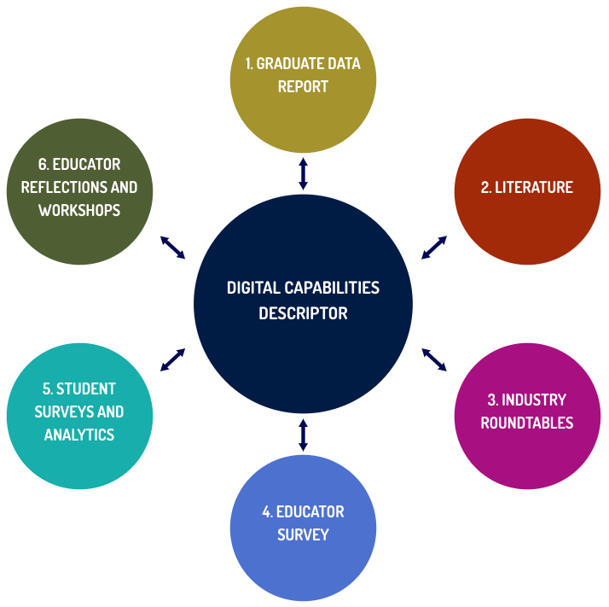
Learning Model Development
Notes:
Digital Descriptors for practice domains (e.g., Data) were developed and defined through a multi-method and iterative process that included analysis of graduate data, literature review, industry roundtables, student and educator surveys, educator reflections and workshops.

Slide 7
Key Themes: Industry Consultation
Data was the current ‘big thing’
  Especially sense making of data to inform strategic decision making AND customer experience/engagement
Grappling with Artificial Intelligence (AI) and Machine Learning emerging as a ‘big thing’
Adaptive digital capability is in high demand but short supply
Notes:
Data was the ‘big thing’ identified in the industry roundtables - sense making of data to inform strategic decision making AND customer experience/engagement. Grappling with Artificial Intelligence (AI), Machine Learning (ML) has also emerged as a ‘big thing’ - Adaptive digital capability is in high demand but short supply

Slide 8
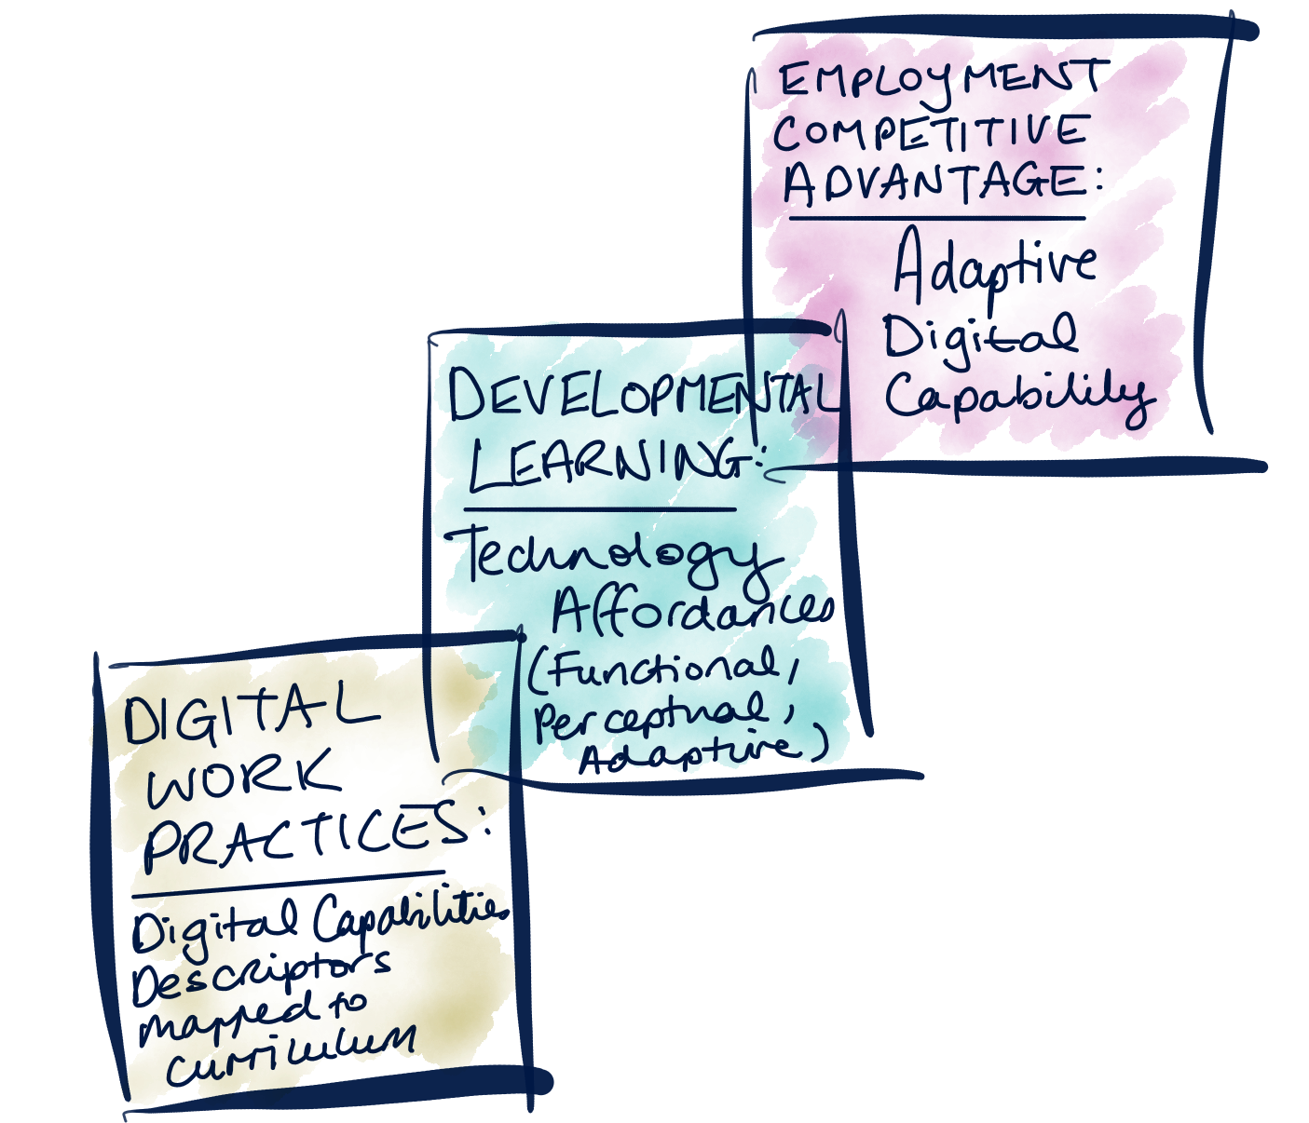
Digital Affordances Developmental Model
Notes:
The Digital Affordance Developmental Learning Model connects digital work practices to the curriculum, through mapping Digital Capabilities Descriptors written in consultation with industry. The Descriptors interpret digital work practices through technology affordance lenses (Functional, Perceptual and Adaptive) for developmental learning about digital work practices.
Graduates who have developed Adaptive digital capability, in particular, potentially have a competitive advantage for graduate employment. Adaptive digital capability is in high demand and short supply, according to the analysis undertaken in this project.

Slide 9
DEFINITION:
‘digital capabilities’ include the knowledge, skills and attributes required for a user to interact productively with technology.
Notes:
DISCUSS how “digital capabilities” are viewed by participants.
What does “digital capabilities” mean for you, in your context?

Slide 10
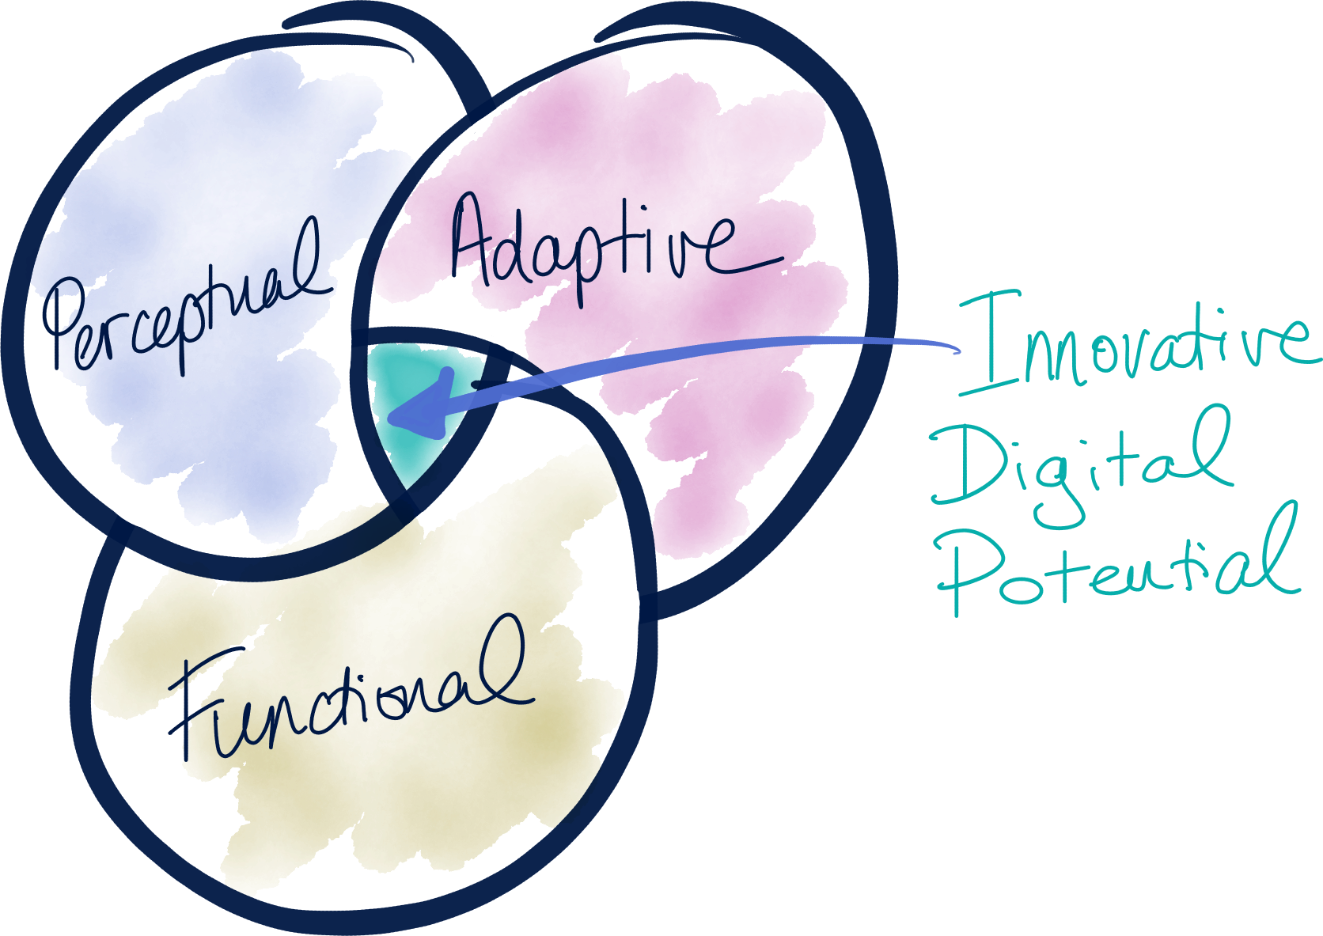
Digital Affordances
Notes:
The model is designed for learners to make the most of technology, by learning to integrate three types of digital affordance/capability: Functional, Perceptual and Adaptive.
These come together to build Innovative Digital Potential.

Slide 11
Digital Affordances
Functional affordances relate to the operation of technology; this includes naming, knowing and operating the features of a technology/technologies to perform tasks.
Perceptual affordances relate to interpretation and being discerning about technology tools and practices for their suitability and in-context operation for outcomes in known contexts.
Adaptive affordances relate to imagining, adapting and extending technology use in previously unexplored and emerging contexts for innovative outcomes; this requires some functional knowledge/skills and perceptual experience.
(Source: adapted from Best 2009; Evans et al. 2017; Fray et al. 2017)
Notes:
Highlight that the difference between Perceptual and Adaptive affordances is that former are related to outcomes in known contexts, while the latter is about creating innovative outcomes in new and emerging contexts.
A key finding of the project is that many times educators and students are focusing on the functional, rather than perceptual and adaptive - even though it is adaptive capability that is most valued by industry.
While we need to avoid assumptions about students as digital natives and therefore functional needs to be addressed, for full Innovative Digital Potential goal of Adaptive, which requires some functional knowledge/skills + perceptual experience.

Slide 12
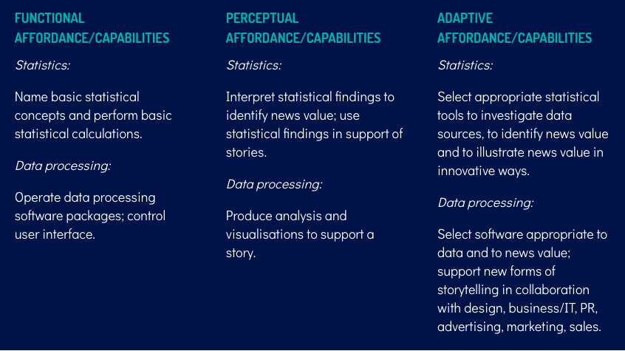
E.g: Data Domain (Journalism)

Slide 13
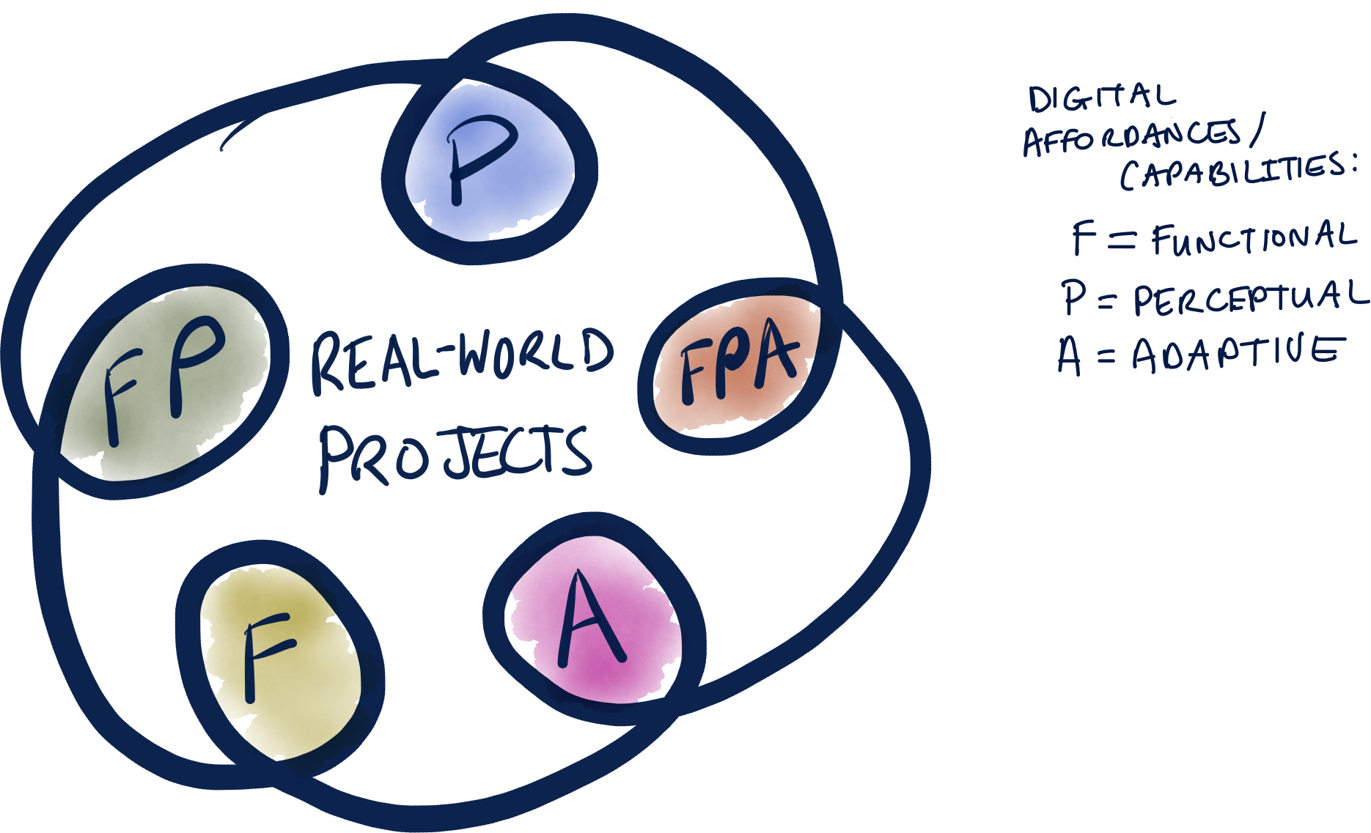
Reflection-in-Action For Building Adaptive Capability
Notes:
NOT JUST LINEAR.
Over time, the learner ideally develops digital capabilities across these three hierarchical but integrated layers. (Adapted from Schon 1983)
Adaptive capability requires some Functional knowledge/skills and Perceptual experience; this may involve knowing enough to work with specialists, rather than having well developed Functional skills oneself.
Reflection-in-action (Schön 1983) is integral to this learning process.

Slide 14
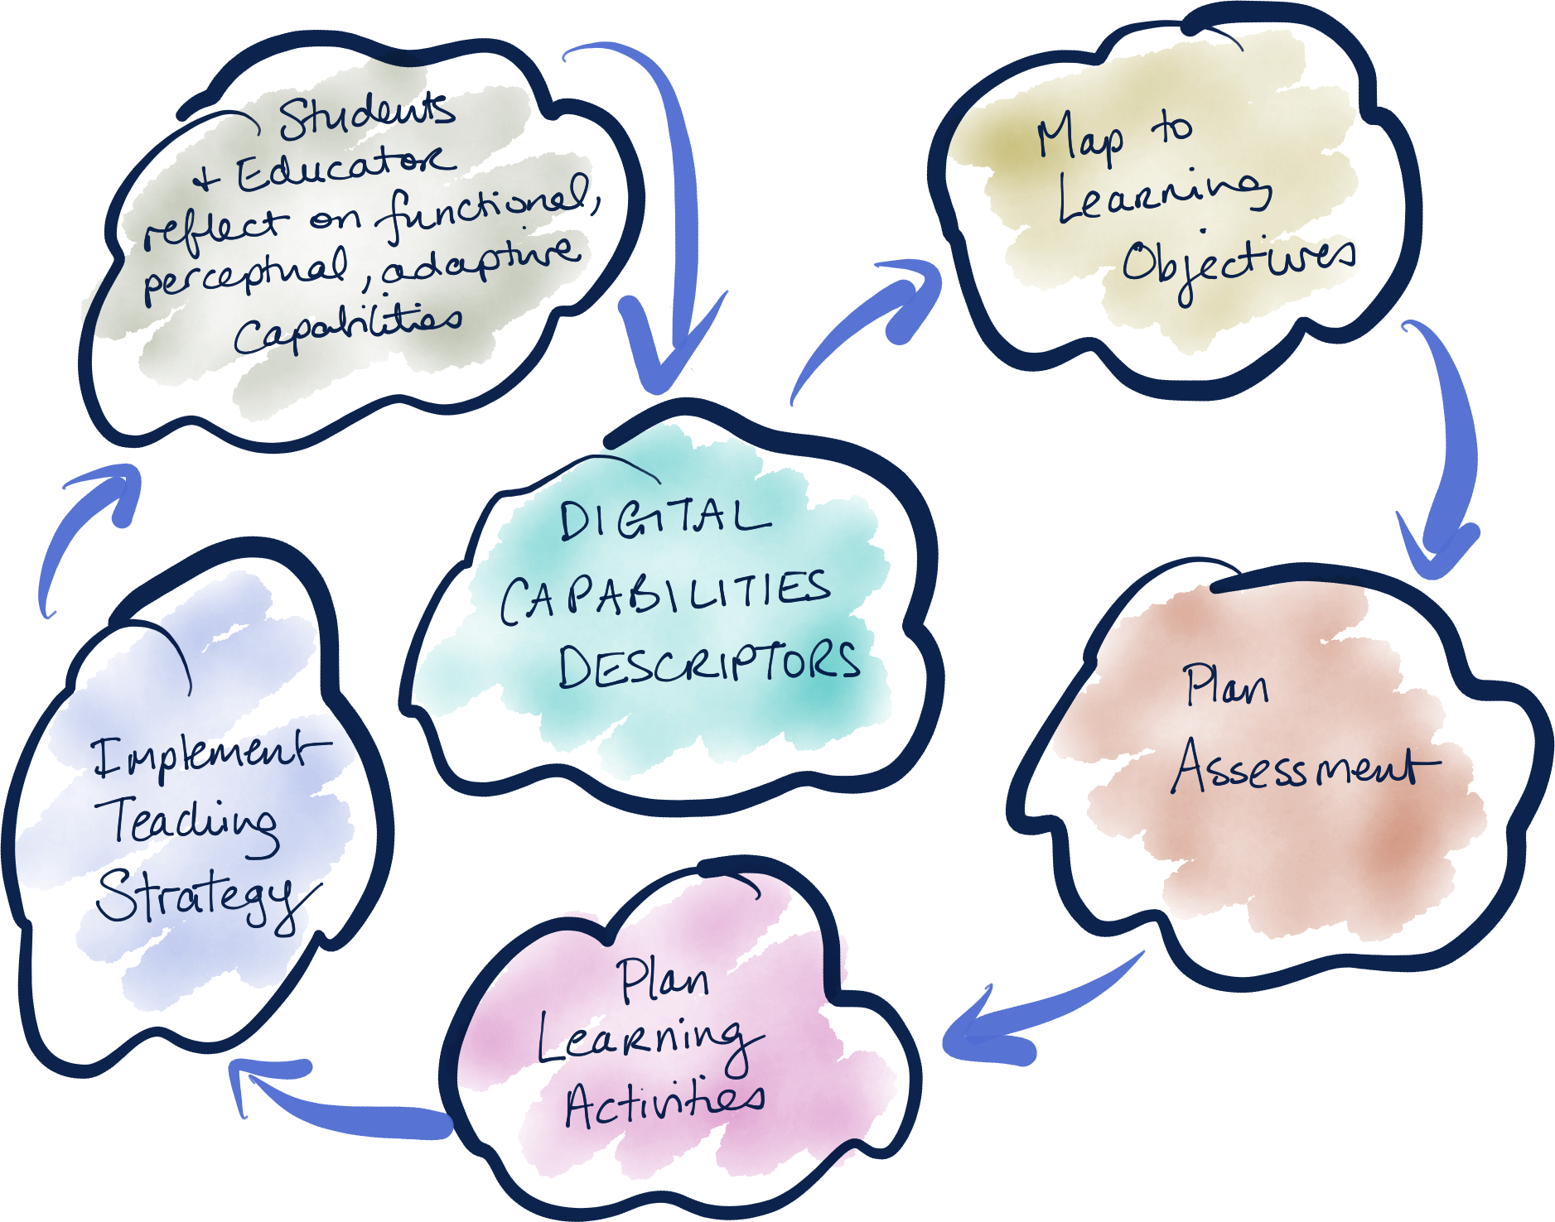
Digital affordance developmental learning model in action
Notes:
The three layers of Functional, Perceptual and Adaptive are hierarchical but integrated. It is vital that students are encouraged to reflect on and discuss the scaffold in relation to their own digital capabilities and practices for work futures.

Slide 15
Using the Learning Model
Digital Capabilities Descriptors can be used in different ways, such as:
guiding the design of assessment and learning activities to enhance existing curriculum
guiding new program and course/unit development
guiding teaching plans focused on particular technology
Notes:
Digital Capabilities Descriptors are at the heart of the model

Slide 16
Identified Success Factors
whole-of-program approaches to implementing the learning model as opposed to isolated interventions
support for students to adopt reflective, analytical and evaluative approaches to the uses of technology
students able to position and discuss their work as demonstrating Functional, Perceptual and (ideally) Adaptive digital capabilities, with insights into further growth needed.
Notes:
identified by teachers who have implemented the model. Reinforced at Educator Workshops in the project.

Slide 17
Examples - see website

Slide 18
What is happening in your industry?
Notes:
Data was the ‘big thing’ identified in the industry roundtables - sense making of data to inform strategic decision making AND customer experience/engagement. Grappling with Artificial Intelligence (AI), Machine Learning (ML) has also emerged as a ‘big thing’ - Adaptive digital capability is in high demand but short supply

Slide 19
How can we better support students
for the future of work?

Slide 20
How might you use this learning model in your teaching?

Slide 21
2. Developing Digital Descriptors for Your Subject

Slide 22
Aims
Practise how to use or adapt digital descriptors
Explore ways to develop digital descriptors

Slide 23
Digital affordance developmental learning model in action
Notes:
Digital Capability Descriptors can help you plan assessments, learning activities and scaffold students to develop their own digital capabilities and practices for work futures.

Slide 24
Different ways to develop Digital Descriptors
Use existing Descriptors
Adapt Descriptors
Create new Descriptors for your discipline
Notes:
You don’t have to create Digital Descriptors from scratch.
The project has developed a number of digital descriptors for domains across Journalism, Design, Music Industry, Business and Engineering. Check these first to see if any are relevant to you.
You can use these as is or adapt them for your subjects.
If there isn’t an existing digital descriptor, you can create your own for key domains in your discipline.

Slide 25
Example: External Communications Domain (Journalism)
Notes:
Here is an example of a digital descriptor created in Journalism for External Communication.

Slide 26
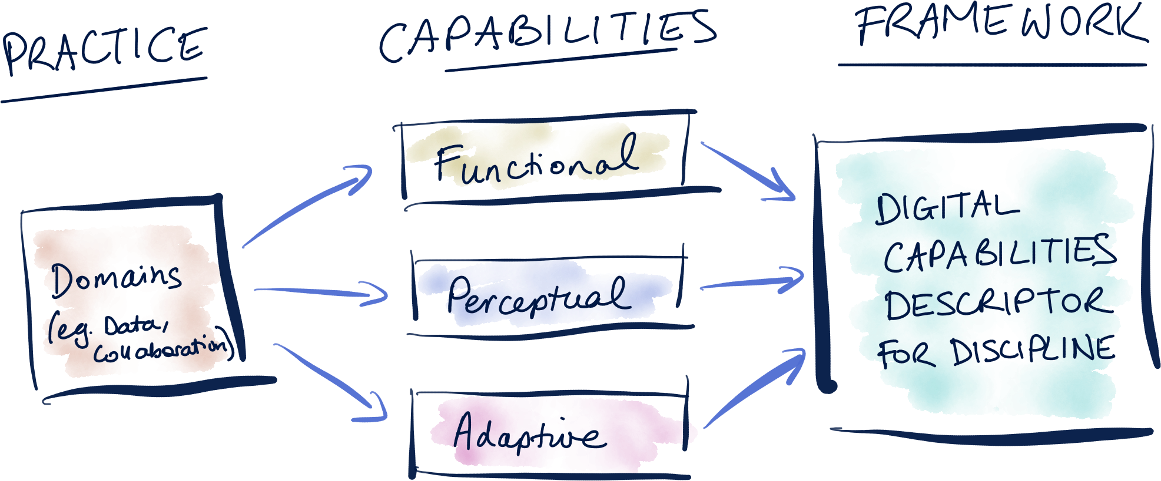
Building the Model
Notes:
BUILDING THE MODEL
Action research cycles have underpinned the iterative development of the learning model as a rapid prototype, with discipline-specific Digital Capabilities Descriptors at its heart. Cycles of industry, educator and student input have been integral to the rapid prototype process.
The Descriptors interpret affordances in sample domains, which are categories of practice and related capabilities for existing and emerging jobs/roles.
The Descriptors start with identifying sample domains of digital practice e.g. data.
The domains might involve digital capabilities that are general and applicable across disciplines (e.g. collaboration) or specialised for specific disciplines (Beetham 2015). What is a general capability in one discipline might be a specialised capability in another.
The domains of practice were then interpreted and described in terms of Functional, Perceptual and Adaptive capabilities.

Slide 27
Process to develop descriptors for your subject
Identify key domains that are relevant to your program/subject in your discipline’s work practices that are critical to students’ job readiness
Check to see if there are existing digital descriptors that fit or could be adapted
If there are no existing digital descriptors, then identify the functional, perceptual and adaptive affordances of each domain
Consultation with industry is recommended!

Slide 28
Which digital capabilities are most important in your program/subject?
Notes:
Prompt: Which of these digital capabilities are most important in your program/subject?
Participants to look through existing domains and select which are relevant.

Slide 29
Can you use existing descriptors
in your program/subject?
Notes:
Participants to review the digital affordances for each selected domains and discuss on tables whether/what adaptation is required.

Slide 30
Identify 1-3 digital capabilities that are important for your program/subject?
Notes:
Prompt: Which of these digital capabilities are most important in your program/subject?
Participants to look through existing domains and select which are relevant.

Slide 31
What are the FUNCTIONAL affordances?
Functional affordances relate to the operation of technology; this includes naming, knowing and operating the features of a technology/technologies to perform tasks.
Notes:
Prompt: What digital capabilities are most important in your program/subject?
Participants to write down 3 domains of digital capability for their graduates.

Slide 32
What are the PERCEPTUAL affordances?
Perceptual affordances relate to interpretation and being discerning about technology tools and practices for their suitability and in-context operation for outcomes in known contexts.
Notes:
Prompt: What digital capabilities are most important in your program/subject?
Participants to write down 3 domains of digital capability for their graduates.

Slide 33
What are the ADAPTIVE affordances?
Adaptive affordances relate to imagining, adapting and extending technology use in previously unexplored and emerging contexts for innovative outcomes; this requires some functional knowledge/skills and perceptual experience.
Notes:
Prompt: What digital capabilities are most important in your program/subject?
Participants to write down 3 domains of digital capability for their graduates.

Slide 34
How do you/can you engage with industry to identify domains, develop and update
digital capability descriptors?
Notes:
How do you currently engage with industry?
What are ways that you could consult and engage industry in identifying domains and updating or developing digital capability descriptors?

Slide 35
3. Using the Learning Model in Teaching

Slide 36
Aims
Develop ideas for how to apply the learning model to your curriculum and lesson planning
Apply digital descriptors to adapt or create Subject Learning Objectives (SLOs)
Explore ideas for assessing digital capabilities
Discuss strategies to implement the learning model in your current practice

Slide 37
Digital affordance developmental learning model in action
Notes:
Digital Capability Descriptors can help you plan assessments, learning activities and scaffold students to develop their own digital capabilities and practices for work futures.

Slide 38
Using the Learning Model
Digital Capabilities Descriptors can be used in different ways, such as:
guiding the design of assessment and learning activities to enhance existing curriculum
guiding new program and course/unit development
guiding teaching plans focused on particular technology
Notes:
Note that the three layers of Functional, Perceptual and Adaptive are hierarchical but integrated. It is vital that students are encouraged to reflect on and discuss the scaffold in relation to their own digital capabilities and practices for work futures.

Slide 39
Reflection in Action For Building Adaptive Capability
Notes:
NOT JUST LINEAR.
Over time, the learner ideally develops digital capabilities across these three hierarchical but integrated layers.
Adaptive capability requires some Functional knowledge/skills and Perceptual experience; this may involve knowing enough to work with specialists, rather than having well developed Functional skills oneself.
Reflection-in-action (Schön 1983) is integral to this learning process.

Slide 40
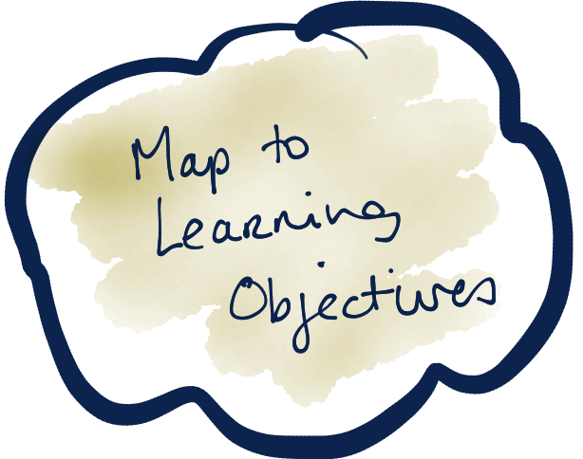

Slide 41
Choose 1-3 domains for your program/subject
Notes:
If participants haven’t already identified the digital descriptors relevant to their subject, ask them to look over the list of domains and choose 1-3 relevant domains and read over their digital capability descriptors

Slide 42
Review your Subject Learning Objectives/Outcomes
How do they match with your domains’ descriptors?
Notes:
Ask them to review their Subject Learning Objectives/Outcomes individually and identify descriptors that are a good fit with Subject Learning Objectives/Outcomes and could be incorporated in learning activities/assessment.
Can the Objectives/Outcomes be used as is or do they need to be adapted (subject to local approval process)?
Participants to share and discuss how they will use descriptors in their SLOs with the Descriptor table.

Slide 43
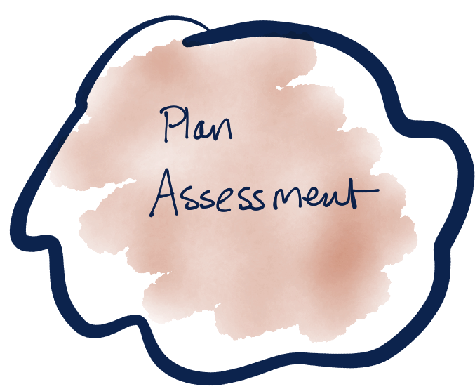

Slide 44
Examples
Notes:
Go to website or distribute examples of assessment questions

Slide 45
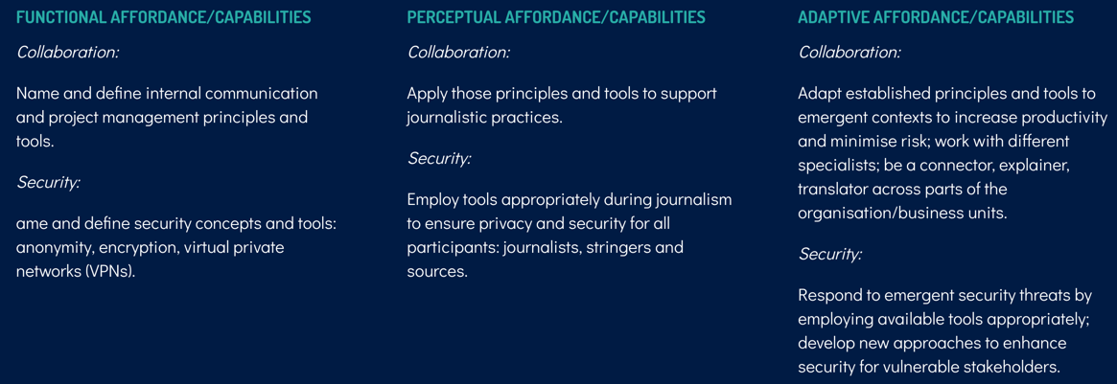
Example: Internal Communications Domain (Journalism)
Notes:
Here is an example of a digital descriptor created in Journalism for External Communication.

Slide 46
EXAMPLE: Functional Assessment (Journalism)
Q. Is Trello primarily a tool for managing A) Workflow, B) Conversations, C) Security.
A. Workflow.
Notes:
With participants in their domain groups, brainstorm ways to assess functional and perceptual affordances - that is in known contexts. (This may require first identifying what are known contexts relevant to their subject.)

Slide 47
EXAMPLE: Perceptual Assessment (Journalism)
Scenario: A media company is looking to launch its titles on a new platform, a stand alone voice-activation device, that can be adapted for media usage and is ‘owned’ by a tech platform keen to work in journalism. There will be a series of work streams in this project organised by you as founder (and thus project manager), among them a tech stream that will be largely staffed by teleworking developers but will require interaction with content generators from all over the world to ensure the content meets its goals.
Notes:
This assessment question could be answered demonstrating perceptual capability but the student may also show more innovative approaches to using and adapting tools.

Slide 48
EXAMPLE: Perceptual Assessment (Journalism) cont.
Q. How would you use the communication, collaboration, work planning and security tools mentioned to set up and manage:
a) regular stand up meetings of the key players,
b) capturing and sharing of the minutes of those meetings,
c) the creation of a specialised technical team who will discuss the programming aspects of the project but also include other key parties, and
d) A way to share and collaborate on tasks.
Notes:
This assessment question could be answered demonstrating perceptual capability but the student may also show more innovative approaches to using and adapting tools.

Slide 49
EXAMPLE: Adaptive Assessment (Journalism)
You are working on a sensitive political story that involves several sources from different countries, each providing documents, and a team of journalists in the U.S., Australia, Indonesia and Singapore. You are concerned about the security of your sources and the risk of surveillance for the entire team.
1. Write a short description of how you would plan and support work flow in such a way as to prioritise the security and privacy of your sources and team.
2. What tools would you use and why?

Slide 50
Choose 1 domain and form groups
Notes:
Participants to choose one domain.
Group together participants who have chosen the same or similar domains.

Slide 51
What are ways you could assess digital capabilities?
Notes:
Participants to choose one domain.
Group together participants who have chosen the same or similar domains.

Slide 52
Functional + Perceptual
Functional affordances relate to the operation of technology; this includes naming, knowing and operating the features of a technology/technologies to perform tasks.
Perceptual affordances relate to interpretation and being discerning about technology tools and practices for their suitability and in-context operation for outcomes in known contexts.
Notes:
With participants in their domain groups, brainstorm ways to assess functional and perceptual affordances - that is in known contexts. (This may require first identifying what are known contexts relevant to their subject.)

Slide 53
Adaptive
Adaptive affordances relate to imagining, adapting and extending technology use in previously unexplored and emerging contexts for innovative outcomes; this requires some functional knowledge/skills and perceptual experience.
Notes:
Then still in domain groups, participants to brainstorm ways to assess adaptive capability.
Participants to share back ideas with the rest of the workshop group.

Slide 54


Slide 55
Examples
Notes:
Go to website for examples or present your own

Slide 56
What are ways that you could apply the learning model to curriculum and lesson planning?
Notes:
Discussion prompt: What are ways that you could apply the learning model to curriculum and lesson planning?
With participants still in their domain groups, participants to brainstorm ways that they can support their students developing that domain on a functional, perceptual and adaptive level.
Participants share their group’s ideas back with the rest of the workshop group.

Slide 57
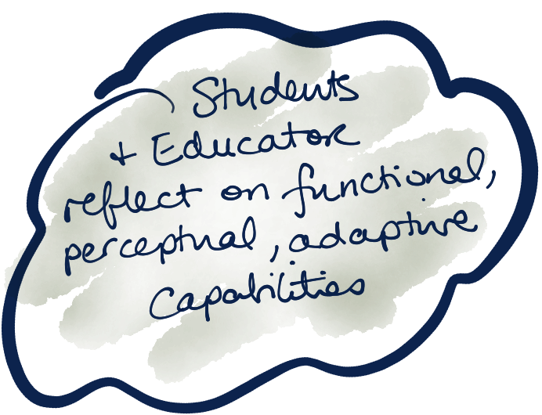
Notes:
Discussion prompt: What are ways that you build in reflection with your students?

Slide 58
What are ways that you build in reflection with your students?

Slide 59
Are there ‘wicked problem’ projects students could work on across disciplines to help develop their Perceptual and Adaptive digital capabilities

Slide 60


Slide 61

Factors that shape our capacity to support learners in developing digital capabilities
In the project’s survey of educators, educators identified factors which contribute and constrain their capacity to support their students to develop digital capabilities:
FACTORS WHICH CONTRIBUTE
FACTORS WHICH CONSTRAIN
Access to technology and software
Technology enabled teaching spaces
Their own capabilities and experience
University support services
Research on digital technologies
Research on industry needs
Professional Development time
Use of industry experts in teaching activities
Insufficient resources
Lack of institution support
Lack of time or capacity to develop own capabilities
Large class sizes
Lack of Professional Development activities related to new technologies
Notes:
RESULTS FROM THE PROJECT’S EDUCATOR SURVEY
We also wondered what was working & not working in relation to teaching those skills, and how much the individual Educators own digital capabilities were a factor.
So we asked them to consider their own digital capabilities rating them as 1 Poor up to 10 Exceptional.
Largely, educators believe their digital skills are above Average (7) – leaving some room for improvement.
Educators in the disciplines of Creative Industries, Media & Science/Engineering rated themselves highest.
The spread of competence was more widely distributed in Business/Management (& education). In fact, no-one in Business rated themselves over an 8 and more than half of the participants rated themselves 6 or below.
Educators also described a range of Factors that could help them improve their ability to teach digital capabilities.
They believe that certain factors contribute to their ability to teach digital capabilities (list on slide)
However there are a range of factors that are currently constraining their ability to teach digital capabilities (list on slide)

Slide 62
How does your current situation support learners in developing digital capabilities?
Notes:
Discussion

Slide 63
How does your current situation constrain learners in developing digital capabilities?
Notes:
Discussion

Slide 64
What is the first thing you would need to do, to make the model work for you with your students?
Notes:
Discussion
Consider ending the workshop with each educator choosing what is the next step they will take to implement the model in their teaching.

