Slide 1
WELCOME

Slide 2
_
Womin djeka
Acknowledgment of Country
RMIT University acknowledges the people of the Woiwurrung and Boon wurrung language groups of the eastern Kulin Nation on whose unceded lands we conduct the business of the University. RMIT University respectfully acknowledges their Ancestors and Elders, past and present. RMIT also acknowledges the Traditional Custodians and their Ancestors of the lands and waters across Australia where we conduct our business.

Slide 3
Thank you
Notes:
Firstly, thank you for taking our pre-service secondary teachers into your schools. This is their last teaching placement and this is where all their learning in the program and their professional experience comes together to demonstrate that they can independently teach in a school.

Slide 4
Introductions
Dr Thembi Mason
Mr Laurie Werrett
Associate Professor Kathy Smith
Notes:
Thembi – Program manager/course coordinator
Laurie – Lecturer

Slide 5
What is a teaching performance assessment?
A teaching performance assessment (TPA) is a tool used to assess the practical skills and knowledge of pre-service teachers. Pre-service teachers collect evidence of practice to complete a TPA in the final year of their initial teacher education program. It is assessed by ITE providers and is a requirement for graduation.
AITSL (https://www.aitsl.edu.au/deliver-ite-programs/teaching-performance-assessment)
Notes:
The idea of a TPA was developed as part of the recommendations from TEMAG to ensure and improve teacher quality in Australia by evidencing preservice teachers’ skills and knowledge against the Australian Teaching Standards.
The GTPA is one of the TPAs that were developed to meet the requirements of this policy initiative to assure quality teacher preparation.

Slide 6
Who is familiar with
the GTPA?
Notes:
Currently, there are 18 Australian HEIs which have joined together as a collective to implement the GTPA in final year of ITE programs.
Ask teachers whether they have previously supervised a student undertaking the GTPA? If so, how have they found it?

Slide 7
The GTPA is about evidencing graduate teachers’ competence and readiness for classroom practice. This evidence needs to be created and collected before and during their placement.
Notes:
The GTPA is a summative assessment for preservice teachers to show that they have met the Australian Graduate Teacher Standards and that they are "classroom ready“. Preservice teachers need to complete a cycle of learning whilst on placement to demonstrate their knowledge and skills in planning, learning and teaching, assessment, reflection and appraisal.
It centres on whole class teaching and differentiated practice, using three focus students to represent the range of achievement levels within the class. It also includes an emphasis on teaching general capabilities such as supporting students' literacy and numeracy knowledge and skills.
In order to complete this assessment, pre-service teachers will need to collect a range of appropriate and sufficient evidence during their teaching placement to use in their report.
They need to evidence their planning, teaching, learning and assessment practices
They need to evidence their pedagogic decision-making
They need to evidence their impact on student learning
They need to evidence their thinking

Slide 8
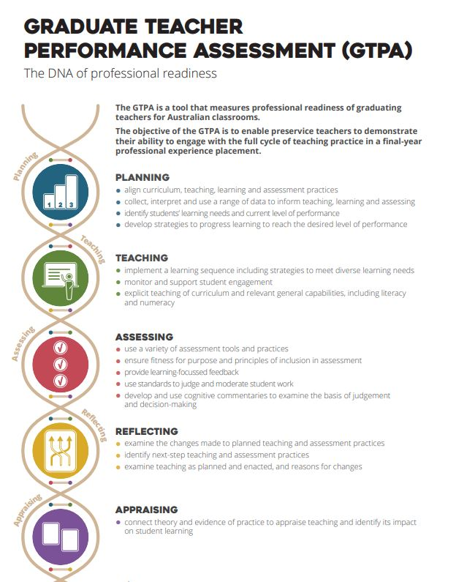
Notes:
The collection of data occurs initially to inform planning and teaching decisions.
During teaching, a range of data is continually collected. Formative assessment of student work, including feedback to students contributes to evidence of learning and further informs adjustments to planning and teaching.
In moderation, preservice teachers share their understandings of how the curriculum and achievement standards apply to student work.
In this cycle, preservice teachers continually reflect and appraise their work to monitor its impact on student learning and to inform next-step planning of teaching. This demonstration of practice includes: making adjustments to meeting the learning needs of all students in the class; making connections between theory and practice; providing evidence of pedagogic decision-making, teaching practices and learning outcomes; and the opportunity to express their emerging professional agency in teaching cycles and scenarios.

Slide 9
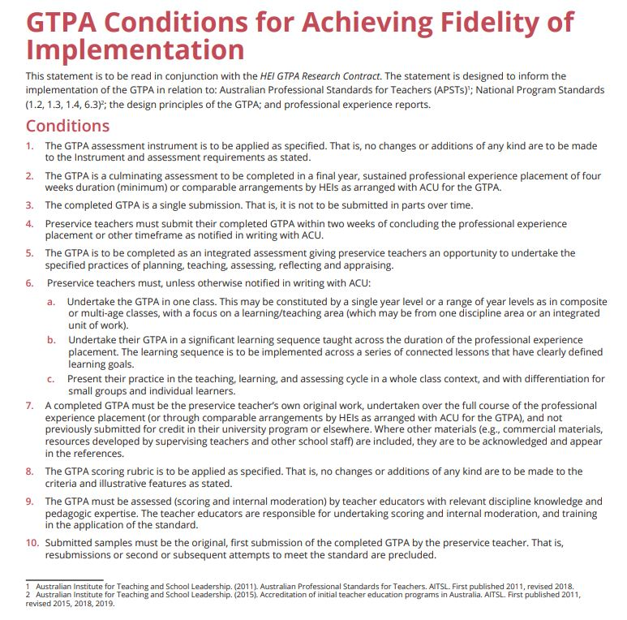
Fidelity of implementation
Notes:
The requirements for completing the GTPA include that a learning sequence must be undertaken in one class and sustained for a minimum of 4 weeks. It needs to be focused on a single learning or teaching area and it is to be significant and implemented across a series of lessons. Preservice teachers’ focus on the whole class teaching and on differentiated practice through the identification of three focus students to represent the range of achievement levels in the class. The PST must take full responsibility for the whole class during the sustained learning focus.
The GTPA is part of a wider research project concerned with identifying performance standards and cross-institutional moderation of judgements. So a number of samples of the GTPA are sent to the consortium to be moderated to ensure that universities across Australia are aligned. All GTPAs are therefore treated as confidential and de-identified so your school, your students and your names are not included in the assessment task.

Slide 10
Assist by providing data to the pre-service teacher that you would normally have access to so that they can make informed decisions about planning for optimal student learning.
Help them to identify three focus students representing the range of capabilities in the class – one at the expected level, below or well-below the level, and above or well above the expected level. Whilst pre-service teachers work with all students within the class, they will be using these three students to identify opportunities for differentiation, and document their specific learning progress
Engage in moderation of the three focus students in their summative task to discuss the use of standards and criteria in assessing student work
Complete the End of Placement form
What is your role?
Notes:
The core planning, teaching and assessing is the role and responsibility of the pre-service teacher.
Where you can assist is providing them with data of the range and type that you would normally have access to so that the pre-service teacher can use that to inform decisions about planning for optimal student learning. This includes data for formative and summative purposes, as well as whole class, small group and individual teaching data. It might be records and observations of classroom talk and patterns of interaction; records of learning; records informed by consultations with individual students or Education support specialists; previous grades achieved, LANTITE results and other standardised test data etc.
They also need to identify three focus students that represent the range of capabilities in the class.
This placement should not involve additional administrative or workload responsibilities for you or your school.

Slide 11
Questions or comments?

Slide 12
Thank you
Notes:
Thank you for your time

